Slide 1
Work by: Evgeny Maslennikov,
Altman Ma,
Siyu Ren
In Jun. 2024

Slide 2
Summary of Sectors Under Study
*Sector Name | No. Companies | **No. Company Into Analysis
Basic Materials | 353 | 225
Consumer Cyclical | 679 | 356
Consumer Defensive | 261 | 148
Consumer Goods | 190 | 114
Communication Service | 302 | 147
Conglomerates | 29 | 18
Energy | 275 | 200
*Sector Name | No. Companies | **No. Company Into Analysis
Financial Services | 1372 | 357
Healthcare | 1308 | 360
Industrial Goods | 85 | 53
Industrials | 720 | 441
Services | 377 | 220
Technology | 1057 | 465
Utilities | 97 | 84
* The list of sectors is provided by EODHD Api.
**In this study, a company is evaluated by its Debt/EBITDA, EPS Yield, Dividend Yield and FCF Yield. Companies lacking essential elements for the above metrics are not taken into analysis.

Slide 3
Summary of Portfolios’ Returns
Sector Name |  | 60 Days | 120 Days | 1 Year
Basic Materials | % With positive return | 56% | 67% | 78%
 | % Outperforming the market | 56% | 44% | 39%
 | Total Average Return | 3.40% | 7.34% | 28.21%
Consumer Cyclical | % With positive return | 52% | 71% | 67%
 | % Outperforming the market | 48% | 43% | 33%
 | Total Average Return | 1.79% | 9.68% | 17.68%
Consumer Defensive | % With positive return | 38% | 56% | 69%
 | % Outperforming the market | 31% | 50% | 31%
 | Total Average Return | -1.77% | 6.96% | 21.73%
Consumer Goods | % With positive return | 42% | 58% | 50%
 | % Outperforming the market | 25% | 33% | 17%
 | Total Average Return | -2.71% | 1.69% | 8.53%
Communication Service | % With positive return | 45% | 45% | 55%
 | % Outperforming the market | 25% | 20% | 20%
 | Total Average Return | 2.40% | -1.09% | 5.98%
Conglomerates | % With positive return | 67% | 67% | 67%
 | % Outperforming the market | 50% | 33% | 33%
 | Total Average Return | 0.65% | 8.49% | 17.28%
Energy | % With positive return | 67% | 86% | 95%
 | % Outperforming the market | 38% | 81% | 52%
 | Total Average Return | 5.47% | 16.17% | 43.15%
S&P 500 Factors | Returns | 2.65% | 6.89% | 23.62%
Sector Name |  | 60 Days | 120 Days | 1 Year
Financial Services | % With positive return | 50% | 50% | 61%
 | % Outperforming the market | 28% | 22% | 22%
 | Total Average Return | 2.40% | -1.09% | 5.98%
Healthcare | % With positive return | 58% | 79% | 74%
 | % Outperforming the market | 53% | 47% | 37%
 | Total Average Return | 4.42% | 10.96% | 17.13%
Industrial Goods | % With positive return | 33% | 67% | 89%
 | % Outperforming the market | 33% | 33% | 89%
 | Total Average Return | 0.11% | 12.23% | 50.53%
Industrials | % With positive return | 60% | 80% | 65%
 | % Outperforming the market | 60% | 55% | 55%
 | Total Average Return | 11.59% | 24.74% | 44.88%
Services | % With positive return | 47% | 58% | 63%
 | % Outperforming the market | 42% | 47% | 37%
 | Total Average Return | 5.21% | 12.30% | 30.27%
Technology | % With positive return | 58% | 79% | 74%
 | % Outperforming the market | 53% | 47% | 37%
 | Total Average Return | 4.42% | 10.96% | 17.13%
Utilities | % With positive return | 67% | 78% | 67%
 | % Outperforming the market | 33% | 44% | 33%
 | Total Average Return | -1.33% | 10.26% | 14.52%
S&P 500 Factors | Returns | 2.65% | 6.89% | 23.62%
*None of the 301 stocks in Other Sector passes the filter before being taken into analysis.

Slide 4
Definition of Best Performing Stocks
In this process, we analyze the performance of stocks basing on 4 metrics:
Debt/ EBITDA
Dividend Yield
EPS Yield
FCF Yield
A good-performing stock should have low Debt/ EBITDA and high in other 3 metrics
First, Stocks with negative EBITDA are dropped to simplify calculation.
Then, stocks are sorted into four list based on the above metrics.
Top X stocks in each list are picked and combined to get a preliminary set.
Then each stock in the preliminary set goes through a check where if it is among the bottom Y stocks on any of the four lists, it should be removed from the set.
The stocks remained in the set after being checked is defined as the best performing stocks.
In each sector, based on the number of the stocks in the sector and the metrics’ distribution, X and Y are chosen to be different pairs of numbers, to get a final investing portfolio with a size between 5 to 20.
For example, in the Healthcare sector, X is selected to be 30 and Y is selected to be 75, while in the Energy Sector X is 50 and Y is 100.

Slide 5
Basic Materials Sector
Among all 353 stocks in Basic materials sector, 225 of which move forward to analysis process. Other stocks are dropped because: 8 stocks lack EPS data; 35 stocks lack debt data; 7 stocks lack shares data; 2 stocks lack EBITDA data; 75 stocks paid zero dividend; 1 stock lacks FCF data.
After eliminating outliers in the stocks by IQR method with sensitivity = 1.5 (This may drop out some best-performing stocks), the stocks in Financial Services sector have the following distribution:
Factors for Best-performing Filter:
X = 75, Y = 120,
Final Size of Portfolio = 18
 | Max | Min | Mean | Median
Debt/EBITDA | 6.44 | -3.24 | 1.71 | 1.45
Dividend Yield | 7.35% | 0.00% | 2.03% | 1.64%
EPS Yield | 16.41% | -7.15% | 5.22% | 4.95%
FCF Yield | 22.98% | -14.98% | 4.14% | 4.34%

Slide 6
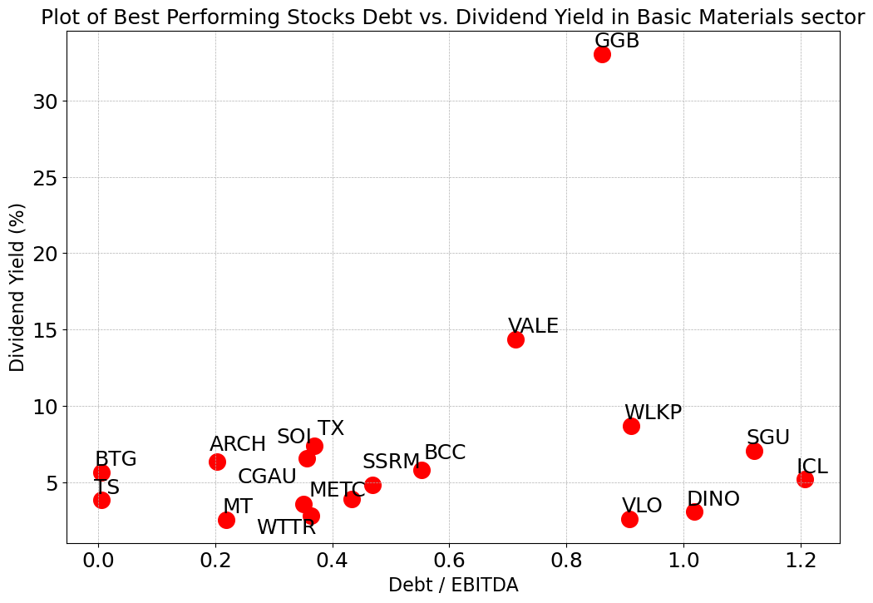
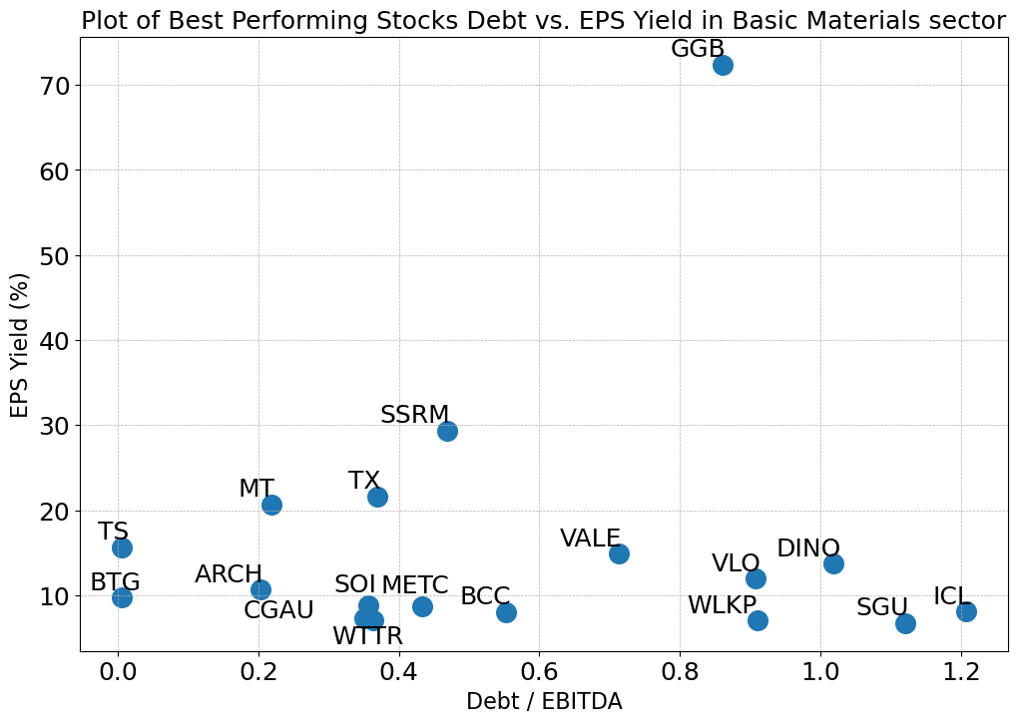
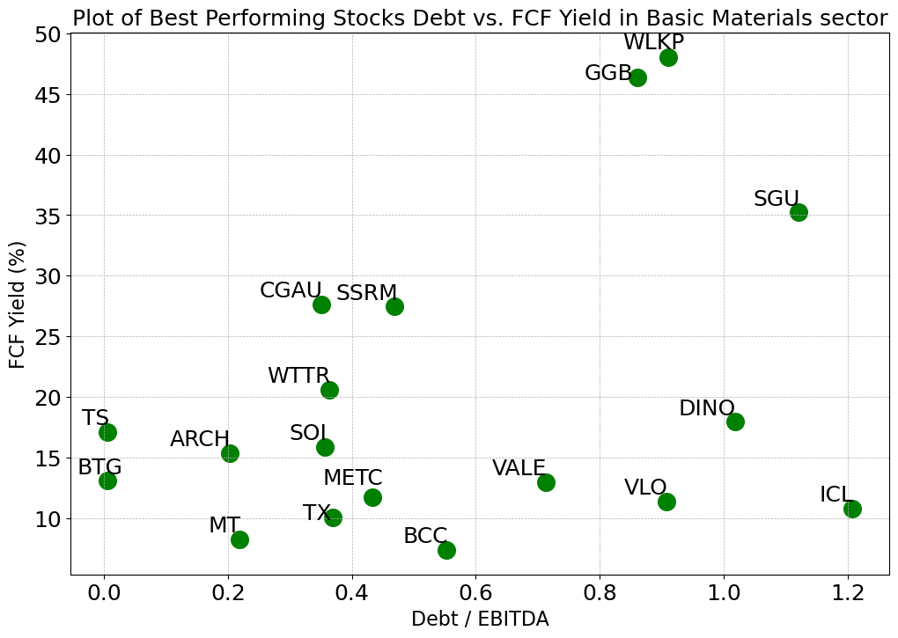
Basic Materials Sector
The best-performing stocks have Debt/EBITDA between 0.0 and 1.22, compared to all 225 stocks with a range of -3.24~6.44 (negative exist because of negative EBITDA)
All but one of the best-performing stocks have a Dividend Yield between 3% and 15%, compared to all 225 stocks with a range of 0%~7.35%
All but one of the 18 stocks have EPS Yields between 6% and 36%, compared to all stocks in -7.15%~16.41%
Most of the 18 stocks have FCF Yields between 7% and 28%, compared to all stocks in -14.98%~22.98%

Slide 7
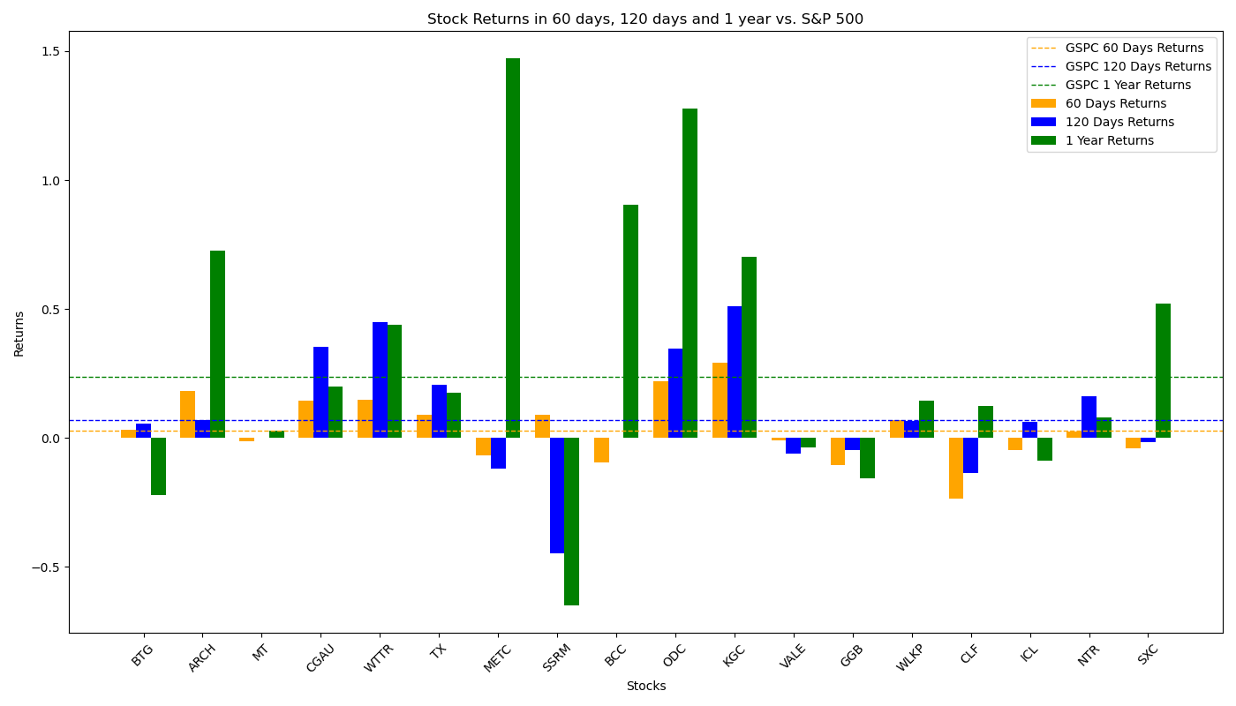
Performance of Filtered Stocks in Basic Materials Sector
Most Filtered Stocks have above-average returns rate in 60-day, 120-day and 1-year sector, higher than that of S&P 500 factors.
*The Returns are calculated simply by change in stock prices.
Total 18 Filtered Stocks | 60 Days | 120 Days | 1 Year
No. Stocks with Positive Returns | 10 | 12 | 14
No. Stocks with Returns Higher than S&P 500 | 10 | 8 | 7
Total Average Returns | 3.40% | 7.34% | 28.21%
Returns of S&P 500 | 2.65% | 6.89% | 23.62%

Slide 8
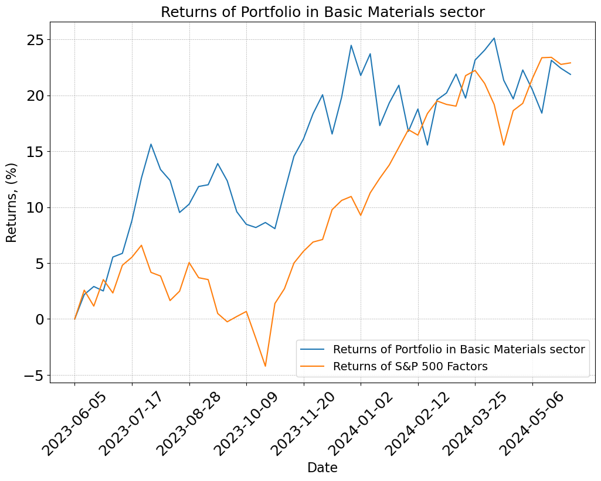
Performance of Filtered Stocks in Basic Materials Sector
In the 1-year period starting from June 2023, the portfolio in Basic Materials had returns significantly higher than average in the first half year but got overlapped in the last few months.
The Standard deviation of the returns of the portfolio is 0.065.

Slide 9
Communication Services Sector
Among all 302 stocks in communication services sector, 147 of which move forward to analysis process. Other stocks are dropped because: 7 stocks lack EPS data; 3 stocks lack price data in a long period; 40 stocks lack debt data; 18 stocks lack shares data; 10 stocks lack EBITDA data; 73 stocks paid zero dividend; 4 stocks lack FCF data.
After eliminating outliers in the stocks by IQR method with sensitivity = 1.5 (This may drop out some best-performing stocks), the stocks in Financial Services sector have the following distribution:
Factors for Best-performing Filter:
X = 50, Y = 60,
Final Size of Portfolio = 19
 | Max | Min | Mean | Median
Debt/EBITDA | 7.73 | -4.13 | 2.67 | 2.62
Dividend Yield | 35.66% | 0.00% | 6.44% | 3.28%
EPS Yield | 22.37% | -22.52% | 3.20% | 3.93%
FCF Yield | 48.80% | -30.11% | 7.99% | 7.48%

Slide 10
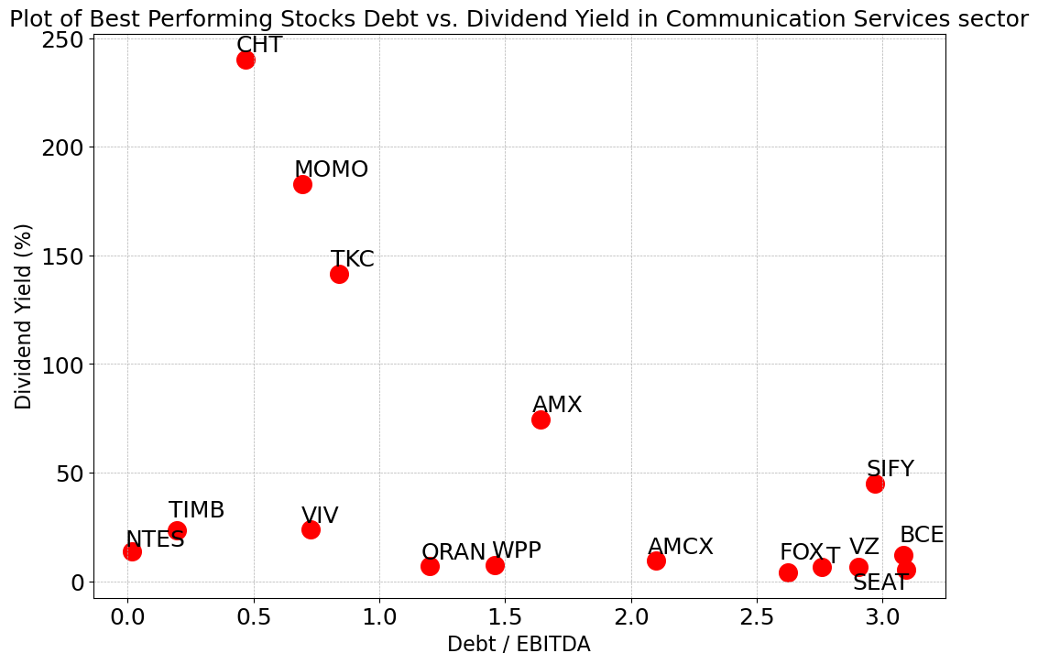
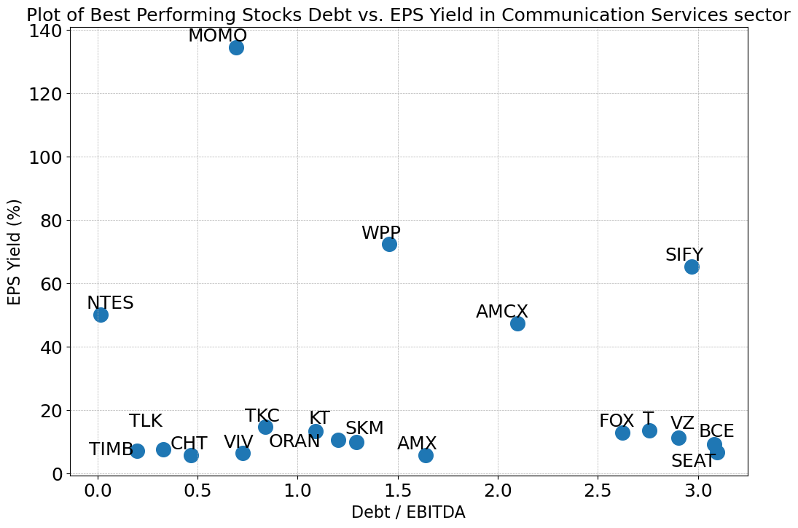
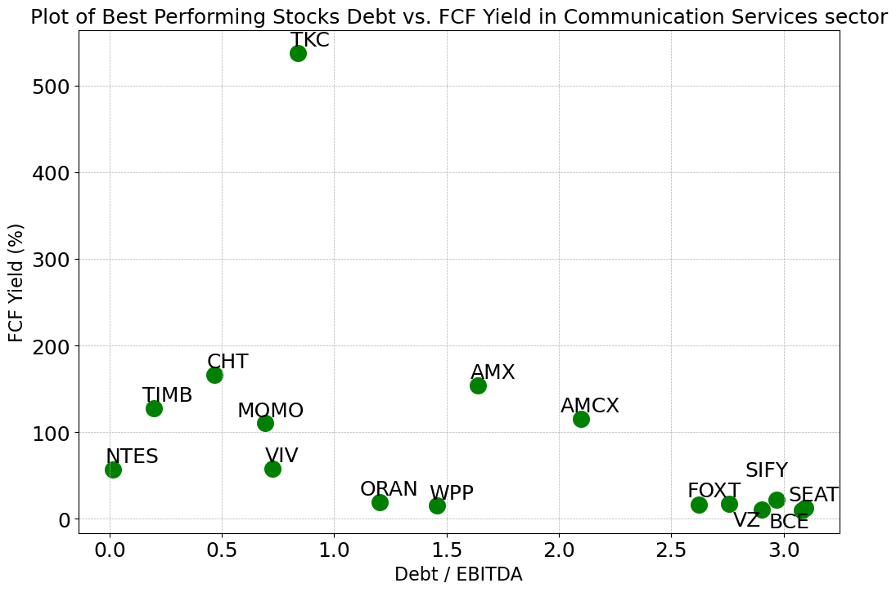
Communication Services Sector
The filtered best-performing stocks have Debt/EBITDA between 0.0 and 3.2, compared to all 147 stocks with a range of -4.13~7.73 (negative exist because of negative EBITDA)
Most of the best-performing stocks have a Dividend Yield between 4% and 240%, compared to all 147 stocks with a range of 0%~0.35.66%
Most of the 19 stocks have EPS Yields between 5% and 73%, compared to all stocks in -22.52%~22.37%
Most of the 19 stocks have FCF Yields between 10% and 167%, compared to all stocks in -30.11%~48.8%
*TLK, SKM and KT have been removed from the Dividend Yield plot and FCF Yield plot since their numbers are extremely high

Slide 11
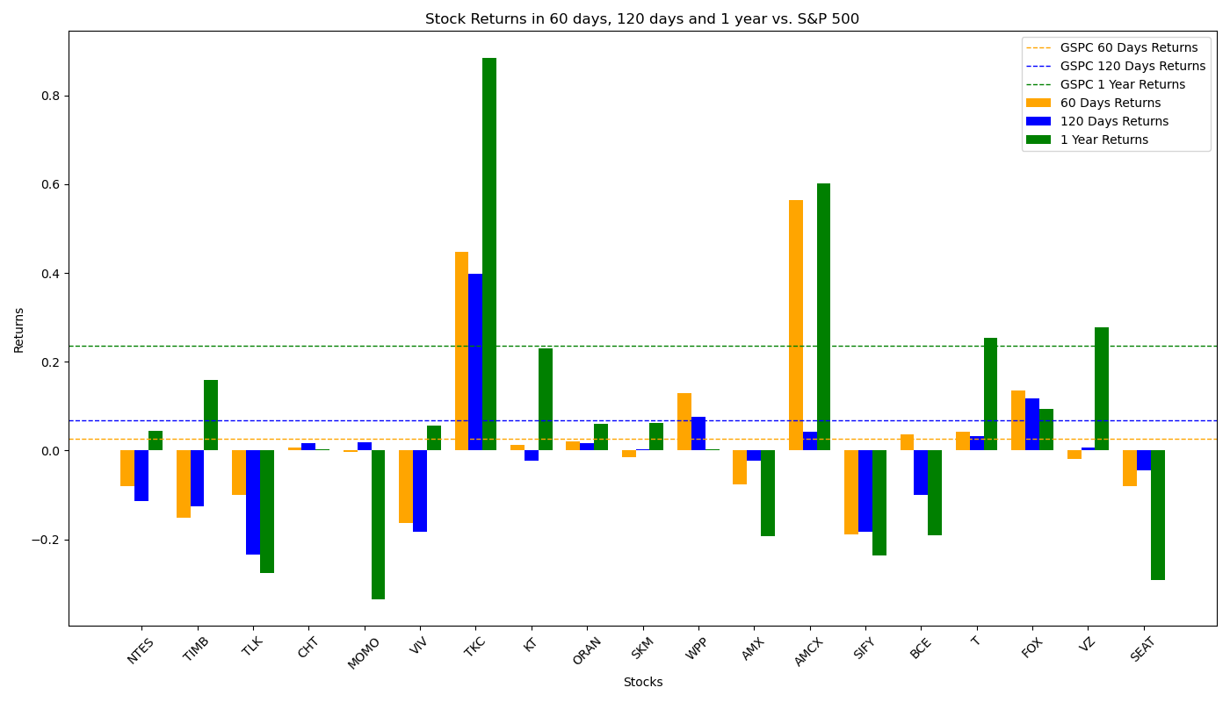
Performance of Filtered Stocks in Communication Services Sector
The Investment Portfolio performs badly in 120-day and 1-year period.
Total 19 Filtered Stocks | 60 Days | 120 Days | 1 Year
No. Stocks with Positive Returns | 9 | 9 | 11
No. Stocks with Returns Higher than S&P 500 | 5 | 4 | 4
Total Average Returns | 2.40% | -1.09% | 5.98%
Returns of S&P 500 | 2.65% | 6.89% | 23.62%

Slide 12
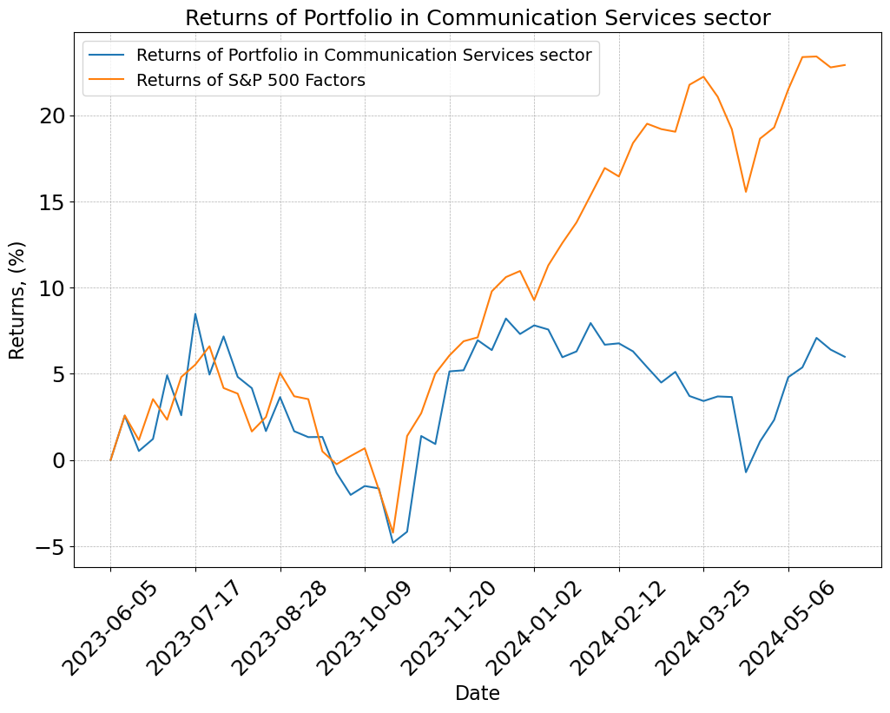
Performance of Filtered Stocks in Communication Services Sector
In the 1-year period starting from June 2023, the returns of the portfolio has a trend like market average in the first half year but became far behind since the beginning of 2024.
The Standard deviation of the returns of the portfolio is 0.032.

Slide 13
Conglomerates Sector
Among all 29 stocks in conglomerates sector, 18 of which move forward to analysis process. Other stocks are dropped because: 3 stocks lack EPS data; 3 stocks lack shares data; 5 stocks paid zero dividend;
After eliminating outliers in the stocks by IQR method with sensitivity = 1.5 (This may drop out some best-performing stocks), the stocks in Financial Services sector have the following distribution:
Factors for Best-performing Filter:
X = 15, Y = 4,
Final Size of Portfolio = 6
 | Max | Min | Mean | Median
Debt/EBITDA | 8.21 | -3.87 | 2.61 | 2.91
Dividend Yield | 8.13% | 0.29% | 2.68% | 2.08%
EPS Yield | 16.32% | 2.83% | 8.36% | 8.56%
FCF Yield | 13.4% | -9.53% | 4.35% | 4.26%

Slide 14
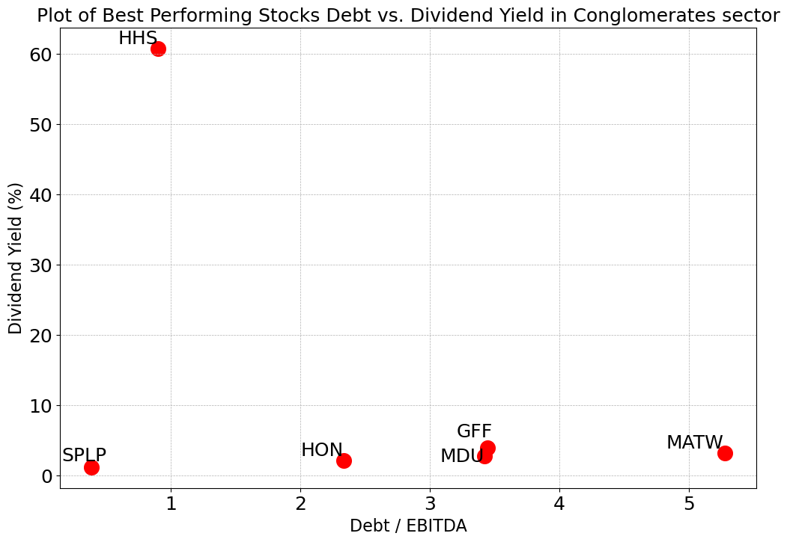
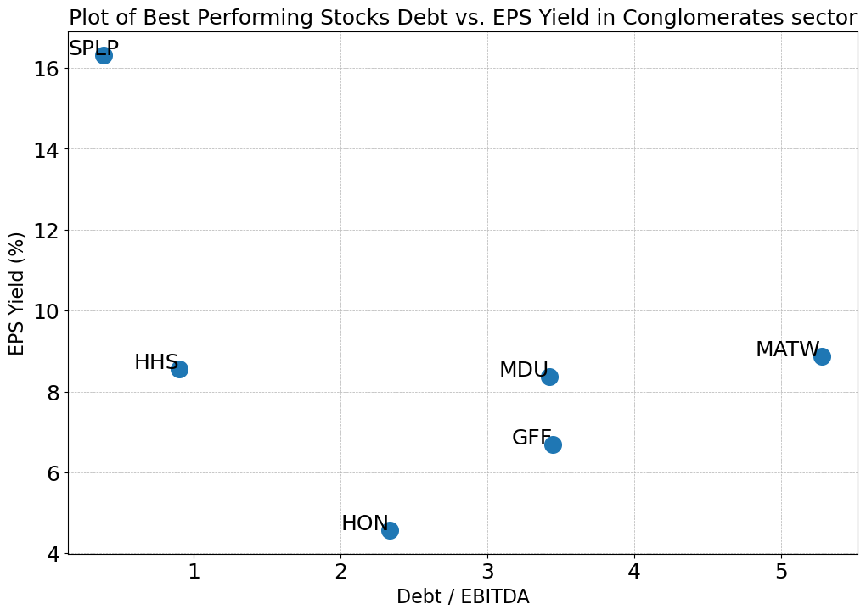
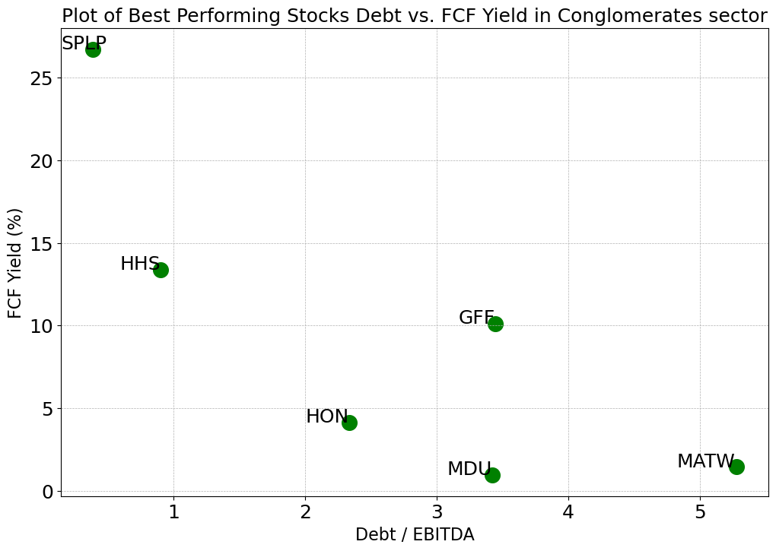
Conglomerates Sector
The filtered best-performing stocks have Debt/EBITDA between 0.0 and 5.3, compared to all 18 stocks with a range of -3.87~8.21 (negative exist because of negative EBITDA)
The filtered best-performing stocks have a Dividend Yield between 1% and 10%, compared to all 18 stocks with a range of 0.29%~8.13%
The filtered 6 stocks have EPS Yields between 4% and 16.2%, compared to all stocks in 2.83%~16.32%
The filtered 6 stocks have FCF Yields between 0% and 27%, compared to all stocks in -9.53%~13.4%

Slide 15
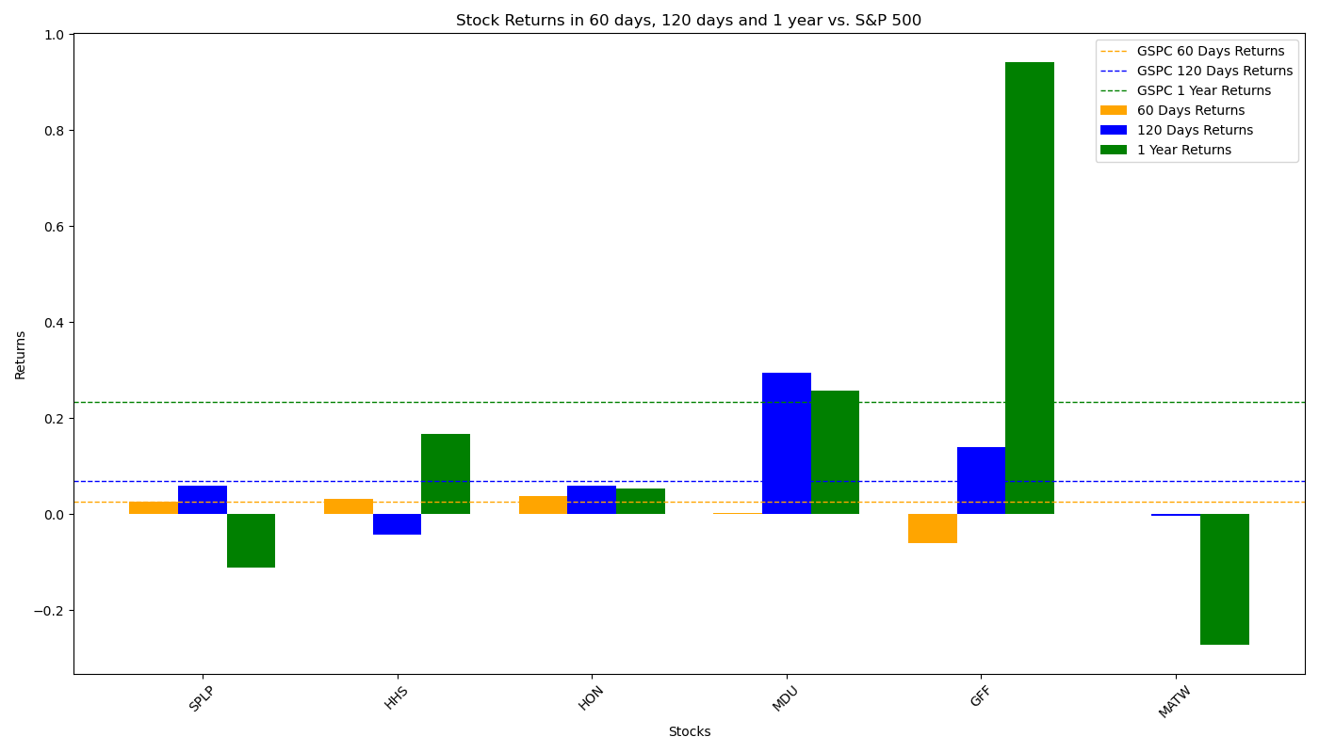
Performance of Filtered Stocks in Conglomerates Sector
The Investment Portfolio performs very well in all three period, with returns much higher than S&P 500 Factors.
Total 6 Filtered Stocks | 60 Days | 120 Days | 1 Year
No. Stocks with Positive Returns | 3 | 4 | 4
No. Stocks with Returns Higher than S&P 500 | 3 | 3 | 3
Total Average Returns | 37% | 11% | 38%
Returns of S&P 500 | 3% | 4% | 12%

Slide 16
Consumer Cyclical Sector
Among all 679 stocks in consumer cyclical sector, 356 of which move forward to analysis process. Other stocks are dropped because: 10 stocks lack EPS data; 9 stocks lack price data in a long period; 65 stocks lack debt data; 36 stocks lack shares data; 23 stocks lack EBITDA data; 175 stocks paid zero dividend; 5 stocks lack FCF data.
After eliminating outliers in the stocks by IQR method with sensitivity = 1.5 (This may drop out some best-performing stocks), the stocks in Financial Services sector have the following distribution:
Factors for Best-performing Filter:
X = 30, Y = 150,
Final Size of Portfolio = 21
 | Max | Min | Mean | Median
Debt/EBITDA | 8.37 | -3.98 | 2.23 | 1.92
Dividend Yield | 13.30% | 0.00% | 2.54% | 1.67%
EPS Yield | 17.80% | -7.34% | 6.09% | 5.69%
FCF Yield | 24.15% | -13.57% | 5.42% | 5.29%

Slide 17
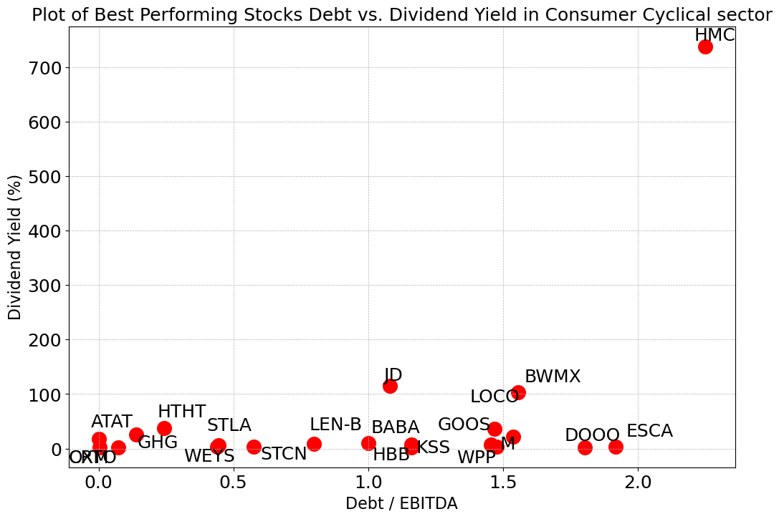
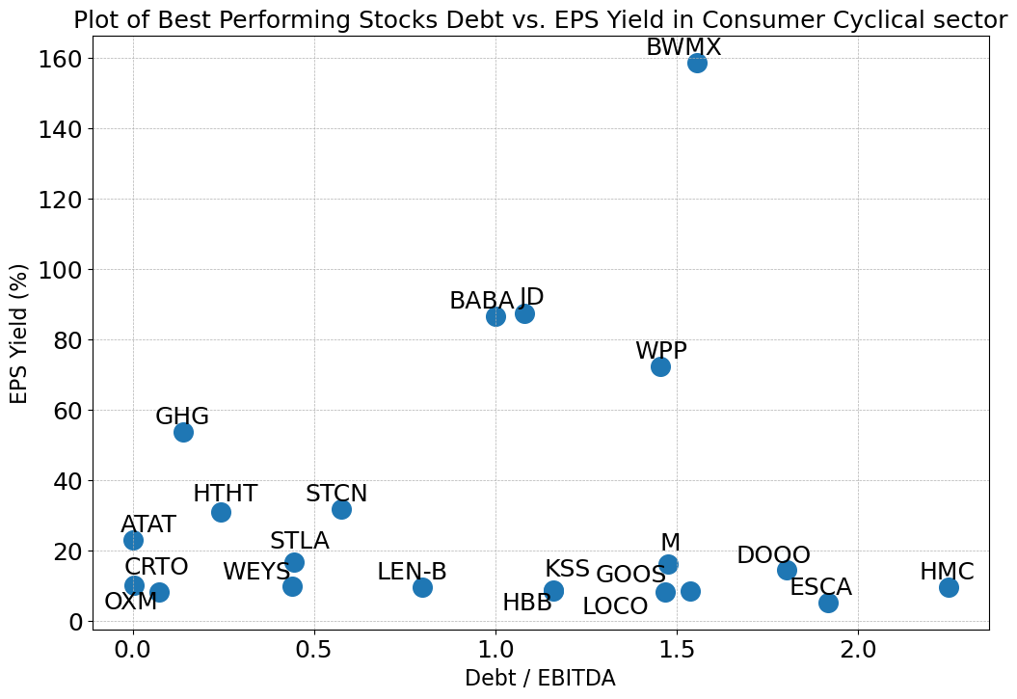
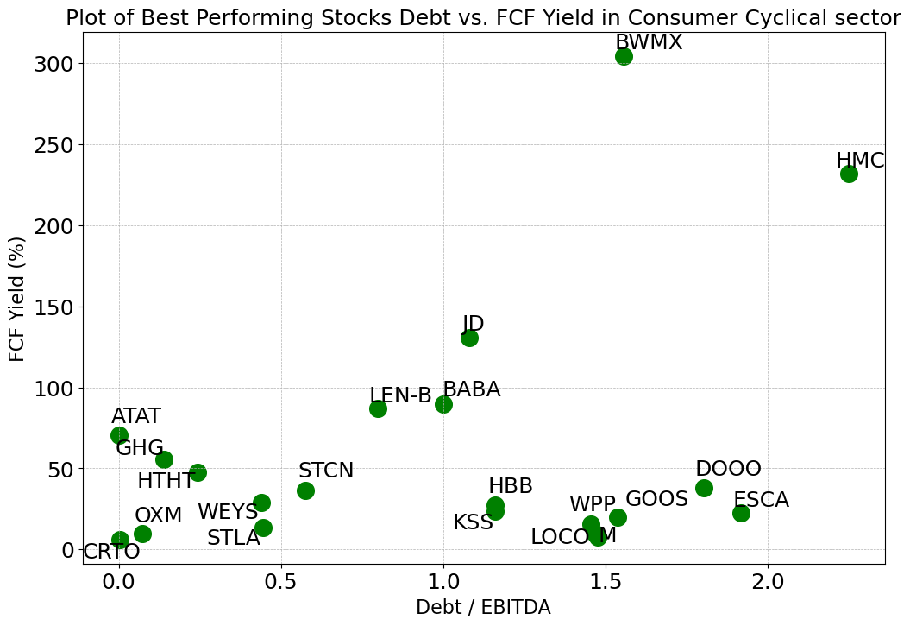
Consumer Cyclical Sector
All but one of the best-performing stocks have Debt/EBITDA between 0.0 and 2.0, compared to all 356 stocks with a range of -3.98~8.37 (negative exist because of negative EBITDA)
All but one of the best-performing stocks have a Dividend Yield between 2% and 114%, compared to all 356 stocks with a range of 0.0%~13.30%
Most of the 21 stocks have EPS Yields between 5% and 88%, compared to all stocks in -7.34%~17.80%
Most of the 21 stocks have FCF Yields between 6% and 131%, compared to all stocks in -13.57%~24.15%

Slide 18
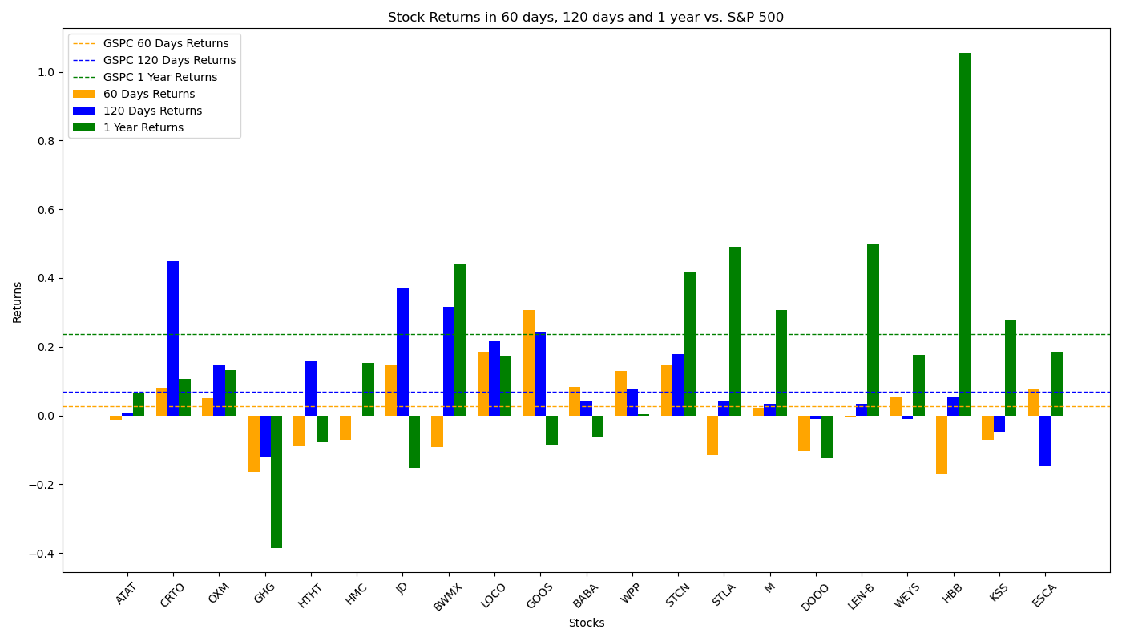
Performance of Filtered Stocks in Consumer Cyclical Sector
The Investment Portfolio performs worse than S&P 500 factors in 60-day and 1-year period but do has positive returns.
Total 21 Filtered Stocks | 60 Days | 120 Days | 1 Year
No. Stocks with Positive Returns | 11 | 15 | 14
No. Stocks with Returns Higher than S&P 500 | 10 | 9 | 7
Total Average Returns | 1.79% | 9.68% | 17.68%
Returns of S&P 500 | 2.65% | 6.89% | 23.62%

Slide 19
Consumer Defensive Sector
Among all 261 stocks in consumer defensive sector, 148 of which move forward to analysis process. Other stocks are dropped because: 6 stocks lack EPS data; 3 stocks lack price data in a long period; 31 stocks lack debt data; 18 stocks lack shares data; 3 stocks lack EBITDA data; 52 stocks paid zero dividend.
After eliminating outliers in the stocks by IQR method with sensitivity = 1.5 (This may drop out some best-performing stocks), the stocks in Financial Services sector have the following distribution:
Factors for Best-performing Filter:
X = 15, Y = 50,
Final Size of Portfolio = 16
 | Max | Min | Mean | Median
Debt/EBITDA | 6.25 | -4.06 | 2.02 | 1.85
Dividend Yield | 14.62% | 0.01% | 3.02% | 2.23%
EPS Yield | 14.27% | -4.10% | 5.83% | 5.26%
FCF Yield | 20.40% | -9.57% | 6.24% | 5.33%

Slide 20
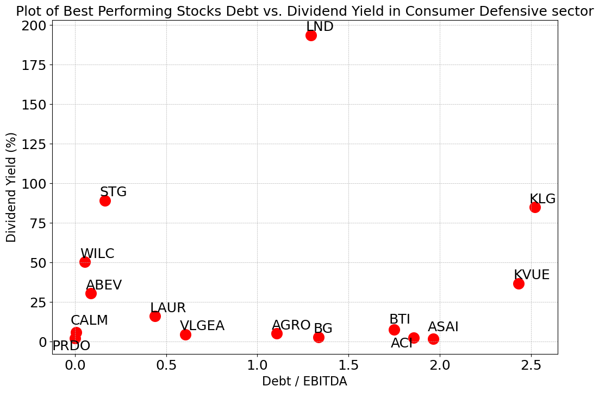
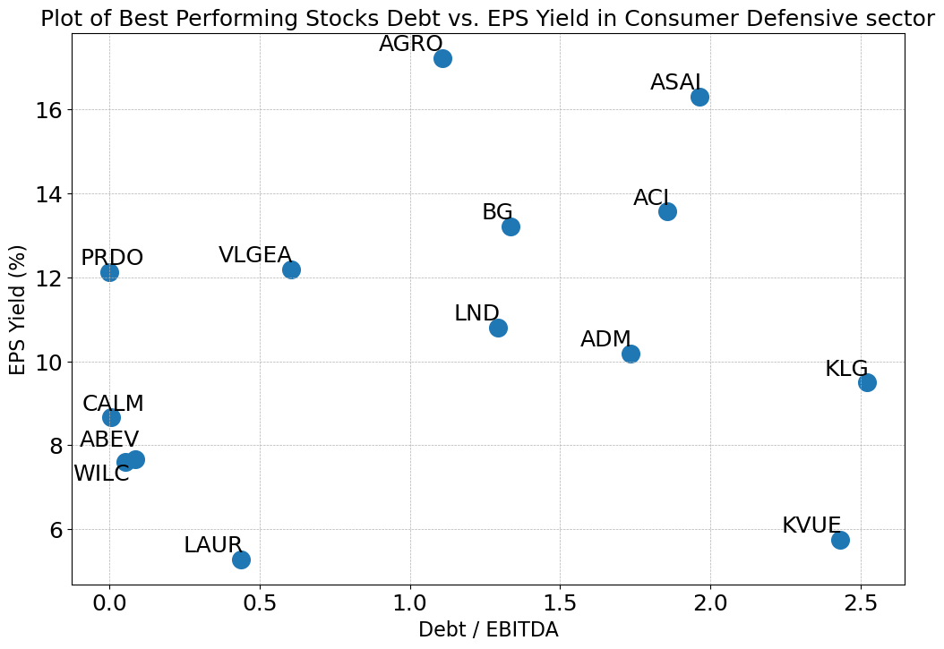
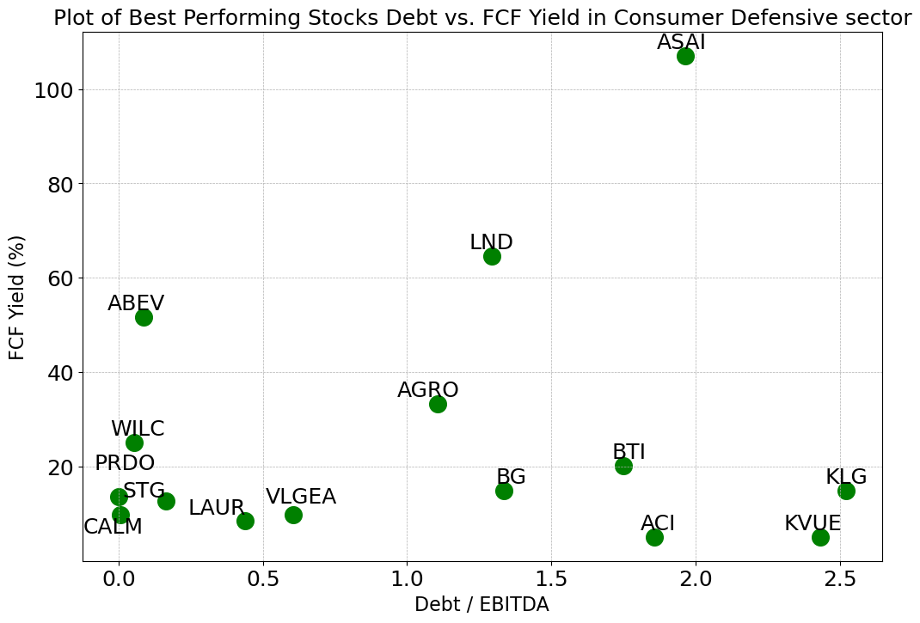
Consumer Defensive Sector
The filtered 15 best-performing stocks have Debt/EBITDA between 0.0 and 2.6, compared to all 148 stocks with a range of -4.06~6.25 (negative exist because of negative EBITDA)
All but one of the best-performing stocks have a Dividend Yield between 2% and 90%, compared to all 148 stocks with a range of 0.01%~14.62%
Most of the 15 stocks have EPS Yields between 5% and 19%, compared to all stocks in -4.10%~14.27%
All but one of the 15 stocks have FCF Yields between 5% and 65%, compared to all stocks in -9.57%~20.40%
*BTI and STG have been removed from the EPS Yield plot since their numbers are extremely high

Slide 21
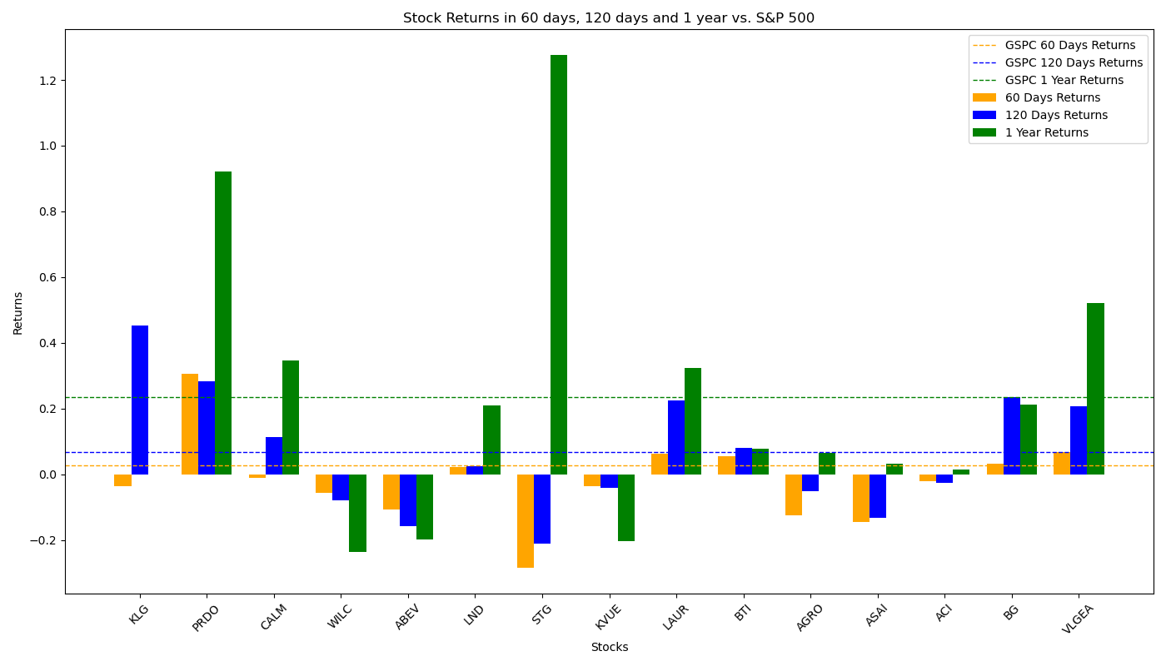
Performance of Filtered Stocks in Consumer Defensive Sector
The Investment Portfolio give negative returns in 60-day period, but in longer periods their performances are close to that of S&P 500’s.
*KLG has no price data before 2023/09/27, so it is excluded from the calculation for 1 year’s returns
Total 16 Filtered Stocks | 60 Days | 120 Days | *1 Year
No. Stocks with Positive Returns | 6 | 9 | 11
No. Stocks with Returns Higher than S&P 500 | 5 | 4 | 4
Total Average Returns | -1.77% | 6.96% | 21.73%
Returns of S&P 500 | 2.65% | 6.89% | 23.62%

Slide 22
Consumer Goods Sector
Among all 190 stocks in consumer goods sector, 114 of which move forward to analysis process. Other stocks are dropped because: 1 stock lack EPS data; 9 stocks lack debt data; 26 stocks lack shares data; 6 stocks lack EBITDA data; 33 stocks paid zero dividend; 1 stock lack FCF data.
After eliminating outliers in the stocks by IQR method with sensitivity = 1.5 (This may drop out some best-performing stocks), the stocks in Financial Services sector have the following distribution:
Factors for Best-performing Filter:
X = 50, Y = 50,
Final Size of Portfolio = 12
 | Max | Min | Mean | Median
Debt/EBITDA | 10.02 | -1.03 | 3.27 | 2.78
Dividend Yield | 9.36% | 0.00% | 3.08% | 2.75%
EPS Yield | 15.34% | -4.10% | 6.09% | 5.42%
FCF Yield | 19.03% | -5.47% | 6.72% | 6.40%

Slide 23
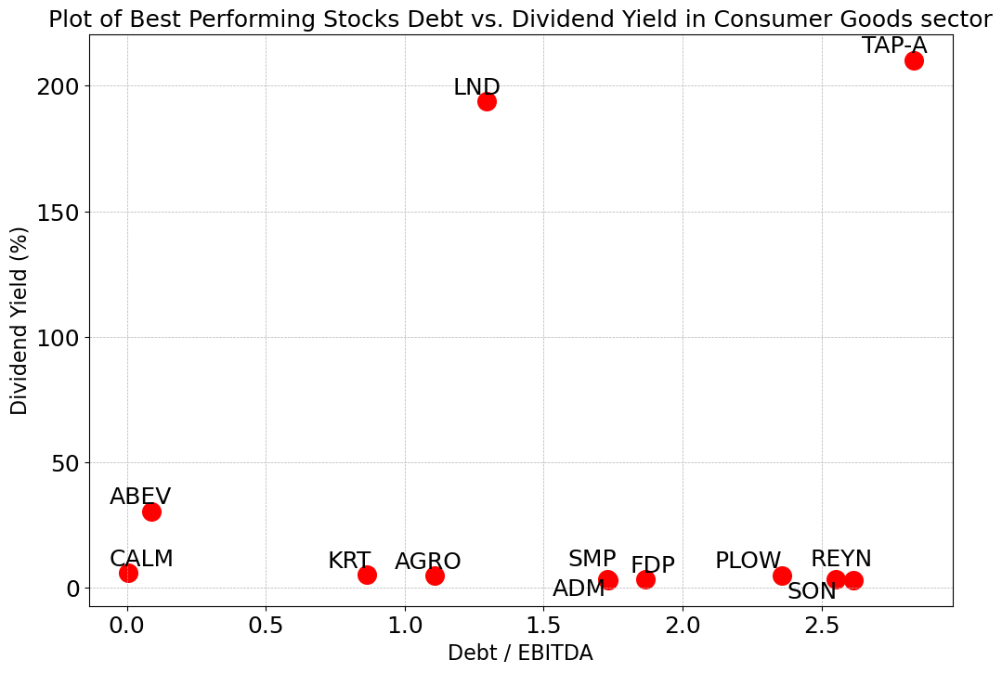
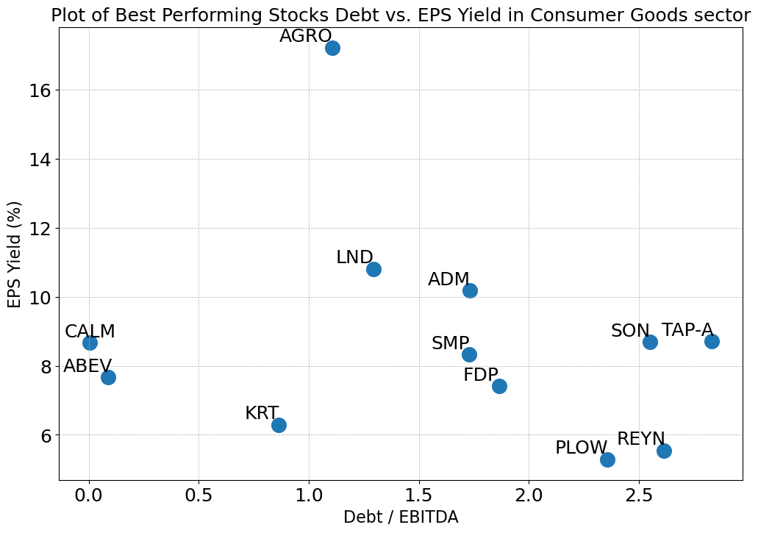
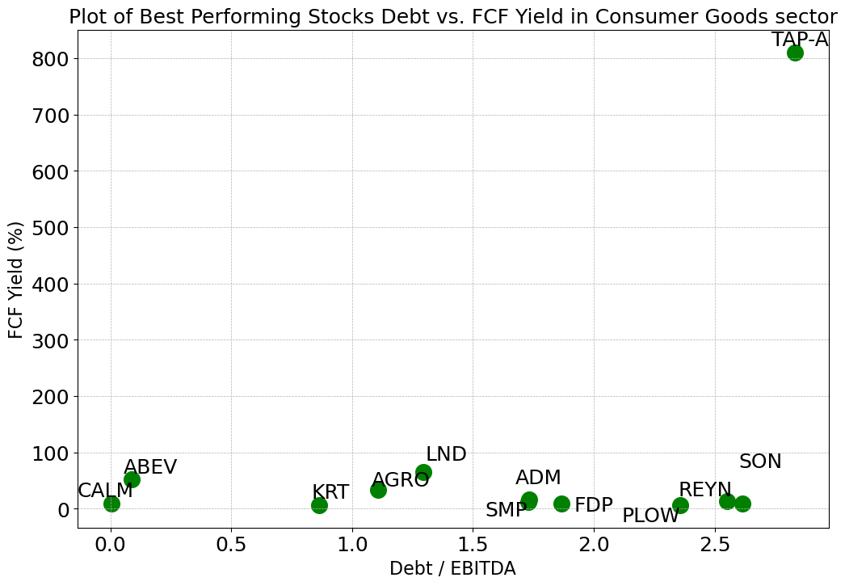
Consumer Goods Sector
The filtered best-performing stocks have Debt/EBITDA between 0.0 and 2.7, compared to all 114 stocks with a range of -1.03~10.02 (negative exist because of negative EBITDA)
Most of the best-performing stocks have a Dividend Yield between 3% and 31%, compared to all 114 stocks with a range of 0%~9.36%
All but one of the 12 stocks have EPS Yields between 5% and 11%, compared to all stocks in -4.10%~15.34%
All but one of the 12 stocks have FCF Yields between 5% and 65%, compared to all stocks in -5.47%~19.03%

Slide 24
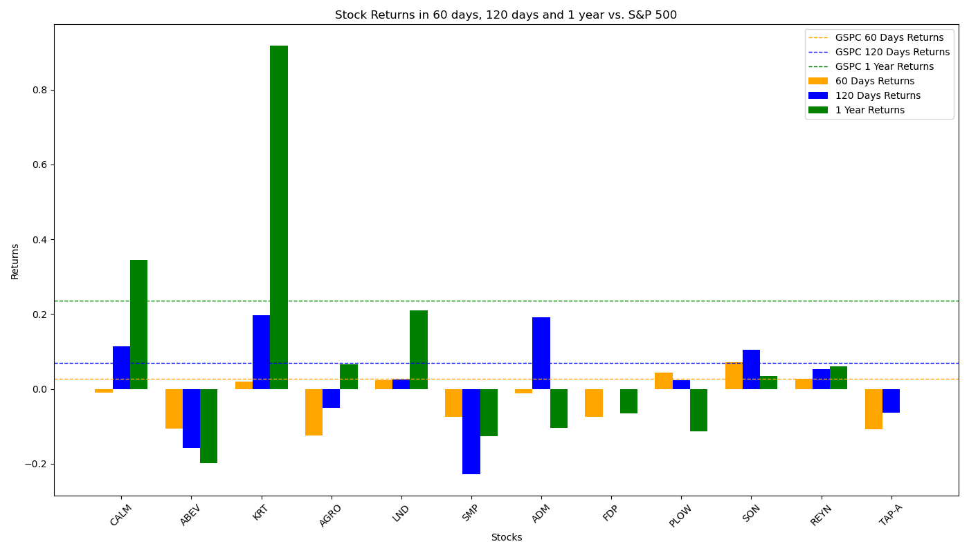
Performance of Filtered Stocks in Consumer Goods Sector
The Investment Portfolio performs below average in all three periods, especially in 60 days where they failed to provide positive returns.
Total 12 Filtered Stocks | 60 Days | 120 Days | 1 Year
No. Stocks with Positive Returns | 5 | 7 | 6
No. Stocks with Returns Higher than S&P 500 | 3 | 4 | 2
Total Average Returns | -2.71% | 1.69% | 8.53%
Returns of S&P 500 | 2.65% | 6.89% | 23.62%

Slide 25
Energy Sector
Among all 275 stocks in energy sector, 200 of which move forward to analysis process. Other stocks are dropped because: 6 stocks lack EPS data; 26 stocks lack debt data; 12 stocks lack shares data; 3 stocks lack EBITDA data; 28 stocks paid zero dividend.
After eliminating outliers in the stocks by IQR method with sensitivity = 1.5 (This may drop out some best-performing stocks), the stocks in Financial Services sector have the following distribution:
Factors for Best-performing Filter:
X = 50, Y = 100,
Final Size of Portfolio = 21
 | Max | Min | Mean | Median
Debt/EBITDA | 6.79 | -1.17 | 1.91 | 1.44
Dividend Yield | 17.17% | 0.00% | 4.32% | 3.14%
EPS Yield | 24.69% | -8.79% | 8.52% | 8.02%
FCF Yield | 29.33% | -16.00% | 7.12% | 7.34%

Slide 26
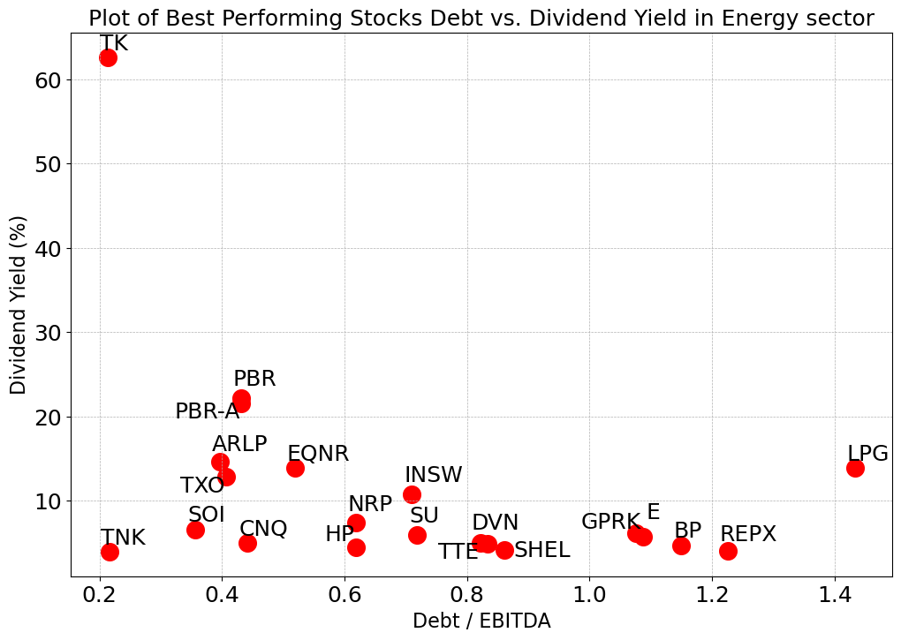
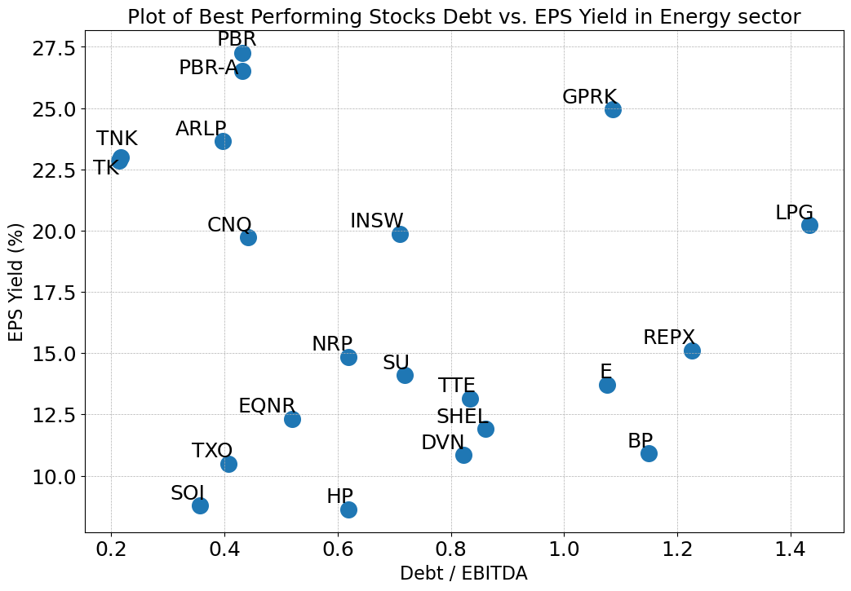
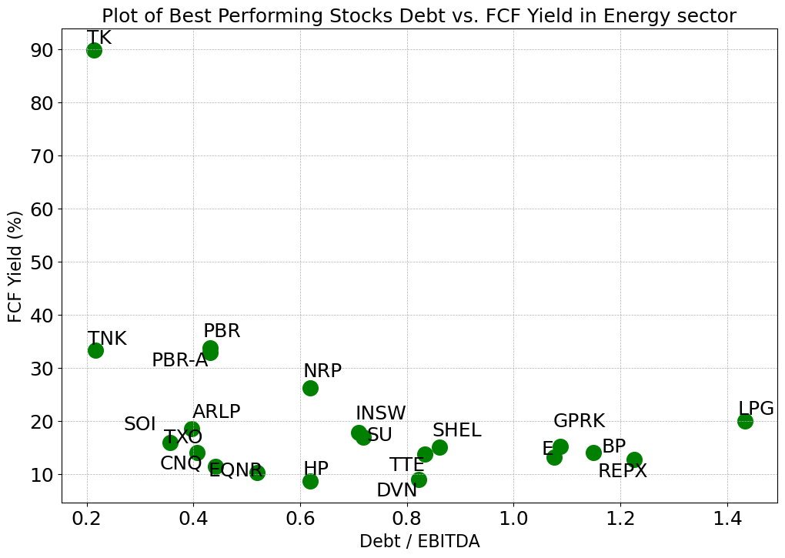
Energy Sector
The filtered best-performing stocks have Debt/EBITDA between 0.0 and 1.5, compared to all 357 stocks with a range of -1.17~6.79 (negative exist because of negative EBITDA)
All but one of the best-performing stocks have a Dividend Yield between 4% and 23%, compared to all 357 stocks with a range of 0%~17.17%
Most of the 21 stocks have EPS Yields between 8% and 27.5%, compared to all stocks in -8.79%~24.69%
Most of the 21 stocks have FCF Yields between 8% and 35%, compared to all stocks in -16%~29.33%

Slide 27
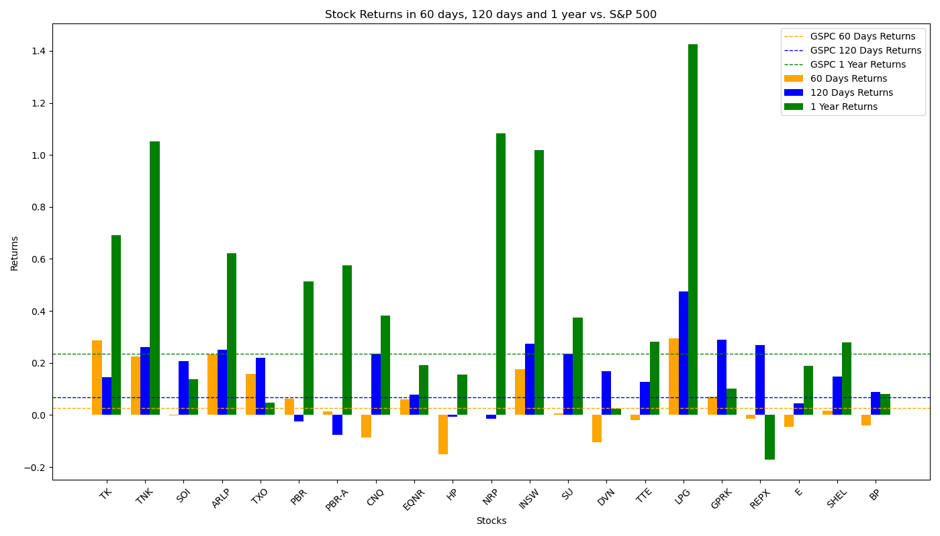
Performance of Filtered Stocks in Energy sector
Most Filtered Stocks have above-average returns rate in 60-day, 120-day and 1-year sector; they perform especially well in a longer term.
Total 21 Filtered Stocks | 60 Days | 120 Days | 1 Year
No. Stocks with Positive Returns | 14 | 18 | 20
No. Stocks with Returns Higher than S&P 500 | 8 | 17 | 11
Total Average Returns | 5.47% | 16.17% | 43.15%
Returns of S&P 500 | 2.65% | 6.89% | 23.62%

Slide 28
Financial Services Sector
Among all 1,372 stocks in financial services sector, 357 of which move forward to analysis process. Other stocks are dropped because: 1) 270 stocks have no financial data in the database; 2) 26 stocks lack EPS data; 3) 32 stocks lack price data in a long period; 4) 500 stocks lack debt data; 5) 86 stocks lack shares data; 6) 11 stocks lack EBITDA data; 7) 85 stocks paid zero dividend; 8) 5 stocks lack FCF data.
After eliminating outliers in the stocks by IQR method with sensitivity = 1.5 (This may drop out some best-performing stocks), the stocks in Financial Services sector have the following distribution:
Factors for Best-performing Filter:
X = 15, Y = 100,
Final Size of Portfolio = 18
 | Max | Min | Mean | Median
Debt/EBITDA | 17.19 | -7.82 | 3.51 | 2.32
Dividend Yield | 22.42% | 0.00% | 5.42% | 3.67%
EPS Yield | 27.14% | -11.45% | 8.28% | 8.20%
FCF Yield | 41.10% | -19.76% | 9.10% | 7.95%

Slide 29
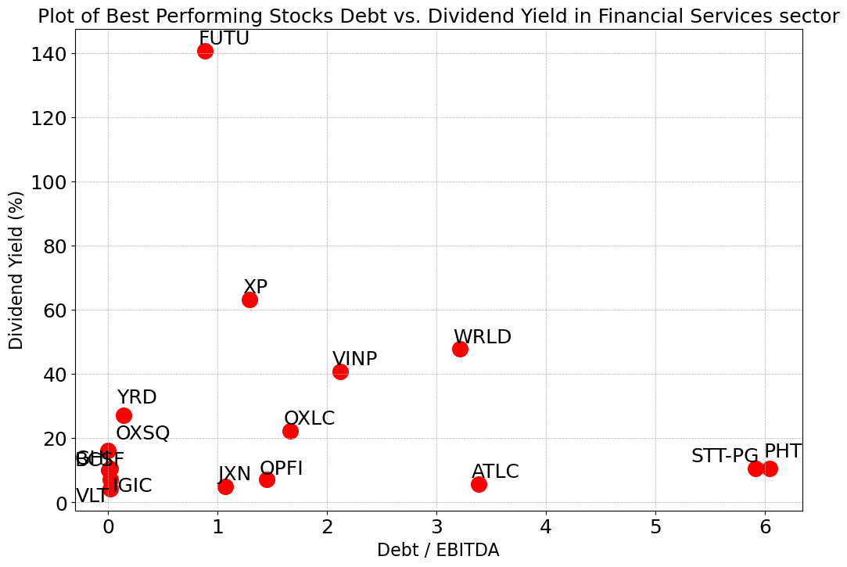
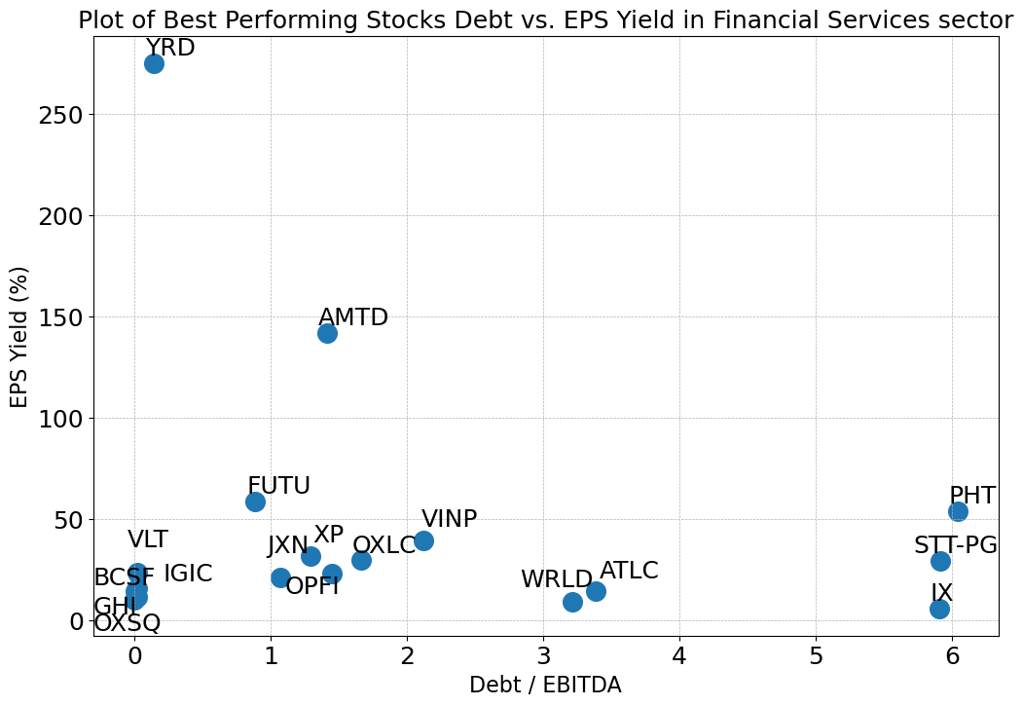
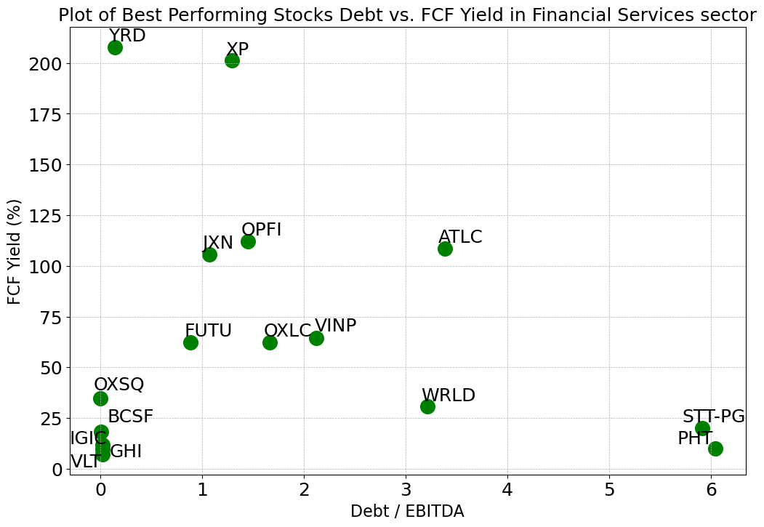
Financial Services Sector
Most of the best-performing stocks have Debt/EBITDA between 0.0 and 3.5, compared to all 357 stocks with a range of -7.82~17.19 (negative exist because of negative EBITDA)
Most of the best-performing stocks have a Dividend Yield between 4% and 64%, compared to all 357 stocks with a range of 0%~22.42%
Most of the 18 stocks have EPS Yields between 5% and 59%, compared to all stocks in -11.45%~27.14%
Most of the 18 stocks have FCF Yields between 7% and 113%, compared to all stocks in -19.76%~41.10%
*IX has been removed from the Dividend Yield plot and FCF Yield plot and AMTD has been removed from FCF Yield since the number is extremely high

Slide 30
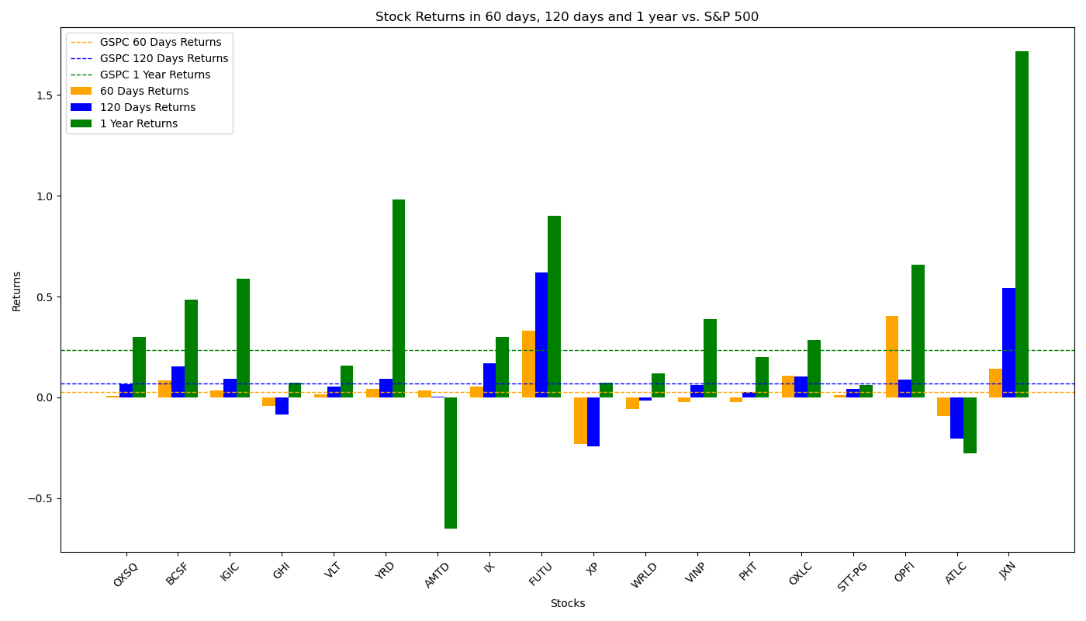
Performance of Filtered Stocks in Financial Service Sector
The Filtered Investment Portfolio performs badly in 120-day and 1-year period.
Total 18 Filtered Stocks | 60 Days | 120 Days | 1 Year
No. Stocks with Positive Returns | 9 | 9 | 11
No. Stocks with Returns Higher than S&P 500 | 5 | 4 | 4
Total Average Returns | 2.40% | -1.09% | 5.98%
Returns of S&P 500 | 2.65% | 6.89% | 23.62%

Slide 31
Healthcare Sector
Among all 1,308 stocks in healthcare sector, 360 of which move forward to analysis process. Other stocks are dropped because: 12 stocks lack EPS data; 12 stocks lack price data in a long period; 299 stocks lack debt data; 55 stocks lack shares data; 30 stocks lack EBITDA data; 536 stocks paid zero dividend; 4 stocks lack FCF data.
After eliminating outliers in the stocks by IQR method with sensitivity = 1.5 (This may drop out some best-performing stocks), the stocks in Financial Services sector have the following distribution:
Factors for Best-performing Filter:
X = 30, Y = 75,
Final Size of Portfolio = 18
 | Max | Min | Mean | Median
Debt/EBITDA | 5.93 | -3.76 | 0.70 | 0.00
Dividend Yield | 21.14% | 0.00% | 2.73% | 0.85%
EPS Yield | 33.84% | -87.90% | -8.01% | 0.75%
FCF Yield | 38.87% | -64.57% | -4.79% | 1.00%

Slide 32
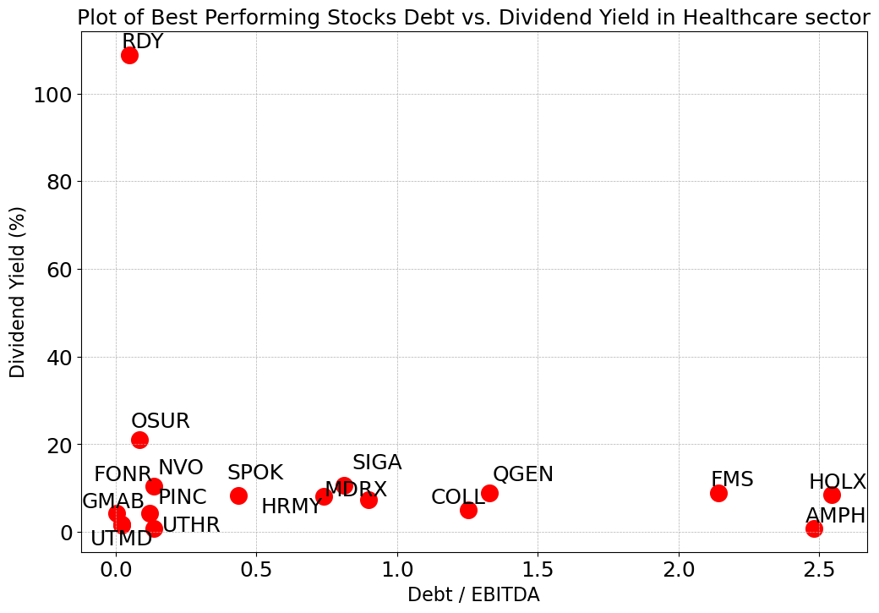
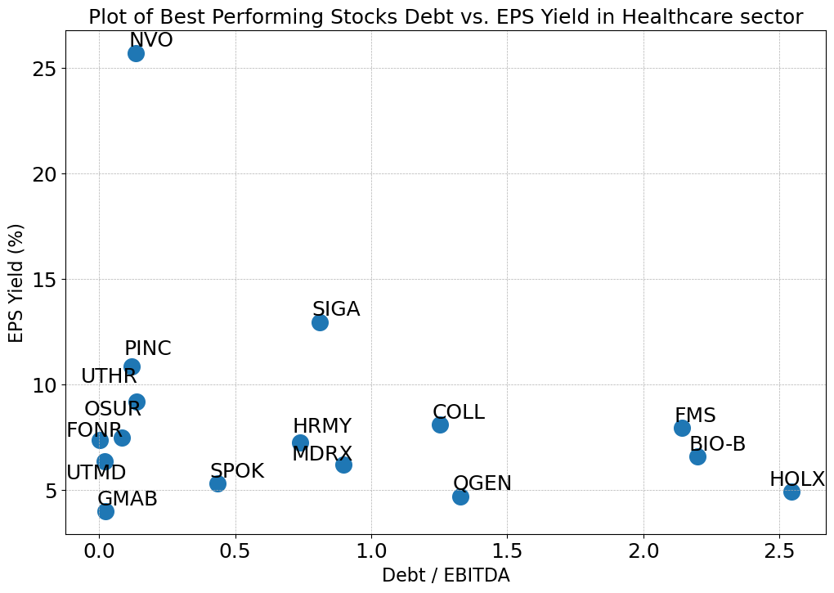
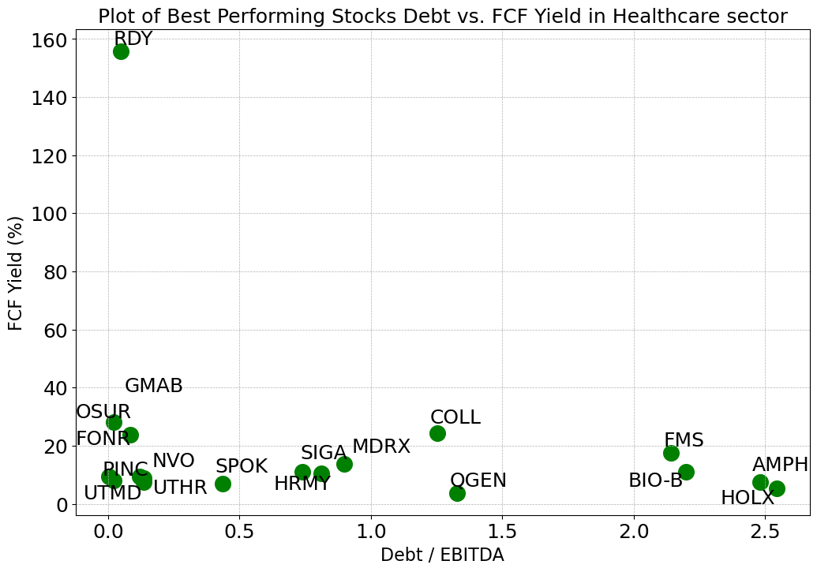
Healthcare Sector
The filtered best-performing stocks have Debt/EBITDA between 0.0 and 2.7, compared to all 360 stocks with a range of -3.76~5.93 (negative exist because of negative EBITDA)
All but one of the best-performing stocks have a Dividend Yield between 0.8% and 22%, compared to all 360 stocks with a range of 0%~21.14%
Most of the 18 stocks have EPS Yields between 4% and 13%, compared to all stocks in -87.90%~33.84%
Most of the 18 stocks have FCF Yields between 3% and 28%, compared to all stocks in -64.57%~38.87%
*NVO has been removed from EPS Yield plot and BIO-B has been removed from the Dividend Yield plot since their numbers are extremely high

Slide 33
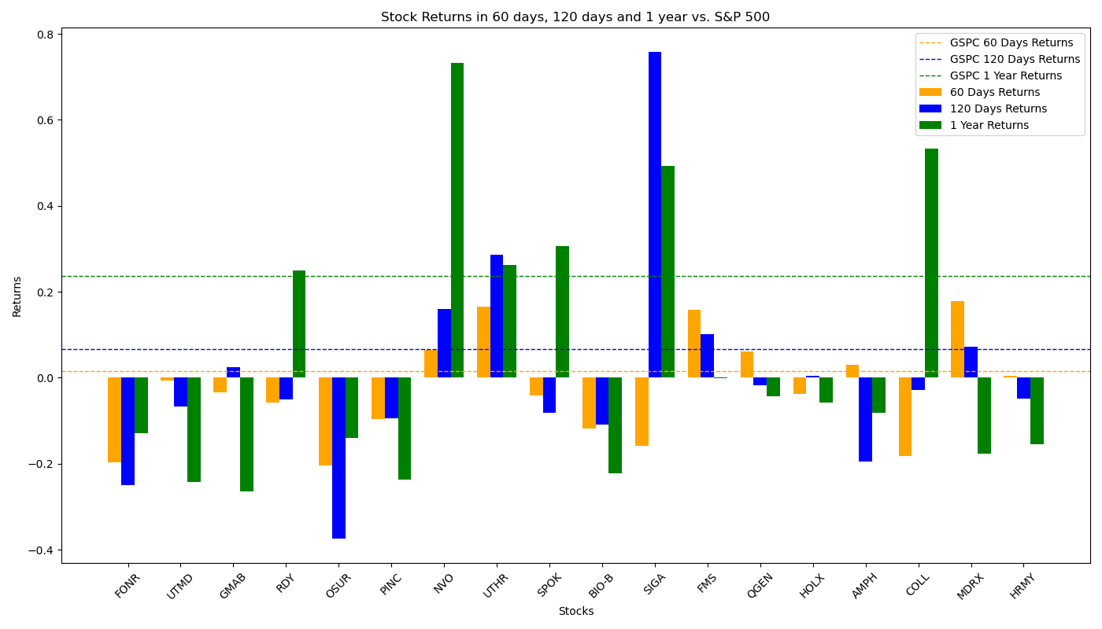
Performance of Filtered Stocks in Healthcare Sector
The Filtered Investment Portfolio doesn’t have a good performance in all periods.
Total 18 Filtered Stocks | 60 Days | 120 Days | 1 Year
No. Stocks with Positive Returns | 6 | 7 | 6
No. Stocks with Returns Higher than S&P 500 | 5 | 5 | 6
Total Average Returns | -2.94% | 1.65% | 5.34%
Returns of S&P 500 | 2.65% | 6.89% | 23.62%

Slide 34
Industrial Goods Sector
Among all 85 stocks in industrial goods sector, 53 of which move forward to analysis process. Other stocks are dropped because: 2 stocks lack price data in a long period; 3 stocks lack debt data; 6 stocks lack shares data; 3 stocks lack EBITDA data; 17 stocks paid zero dividend; 1 stock lack FCF data.
After eliminating outliers in the stocks by IQR method with sensitivity = 1.5 (This may drop out some best-performing stocks), the stocks in Financial Services sector have the following distribution:
Factors for Best-performing Filter:
X = 20, Y = 20,
Final Size of Portfolio = 9
 | Max | Min | Mean | Median
Debt/EBITDA | 6.11 | -1.11 | 1.94 | 1.73
Dividend Yield | 2.69% | 0.00% | 0.87% | 0.79%
EPS Yield | 19.12% | -9.30% | 5.96% | 4.85%
FCF Yield | 12.35% | -8.93% | 3.40% | 4.02%

Slide 35
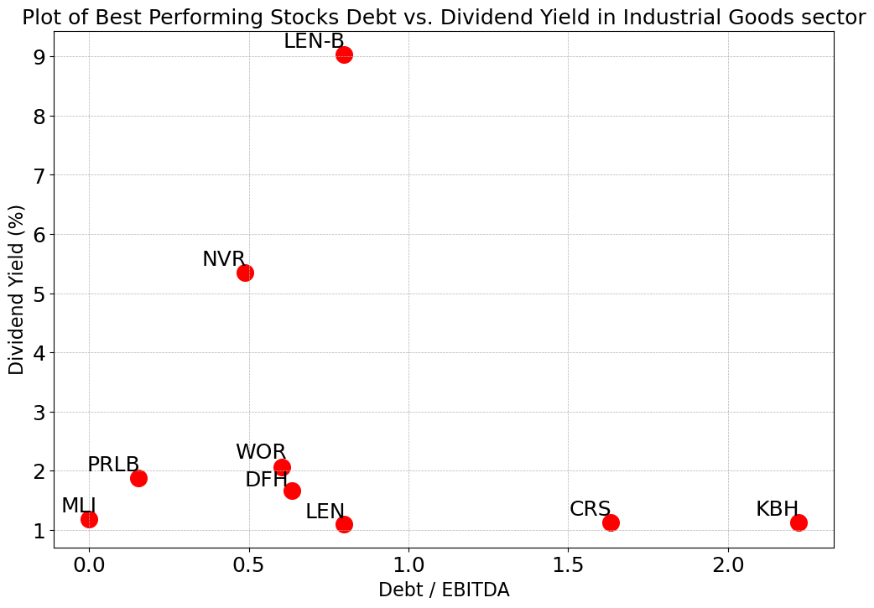
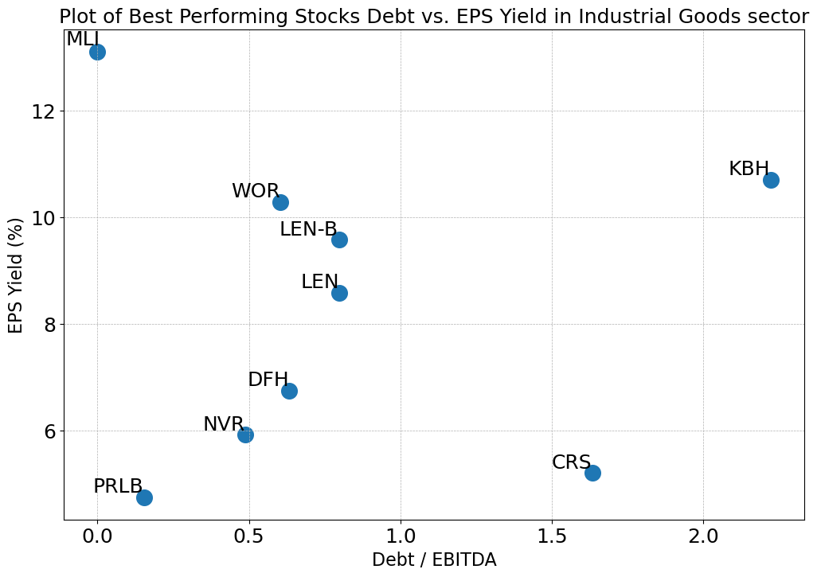
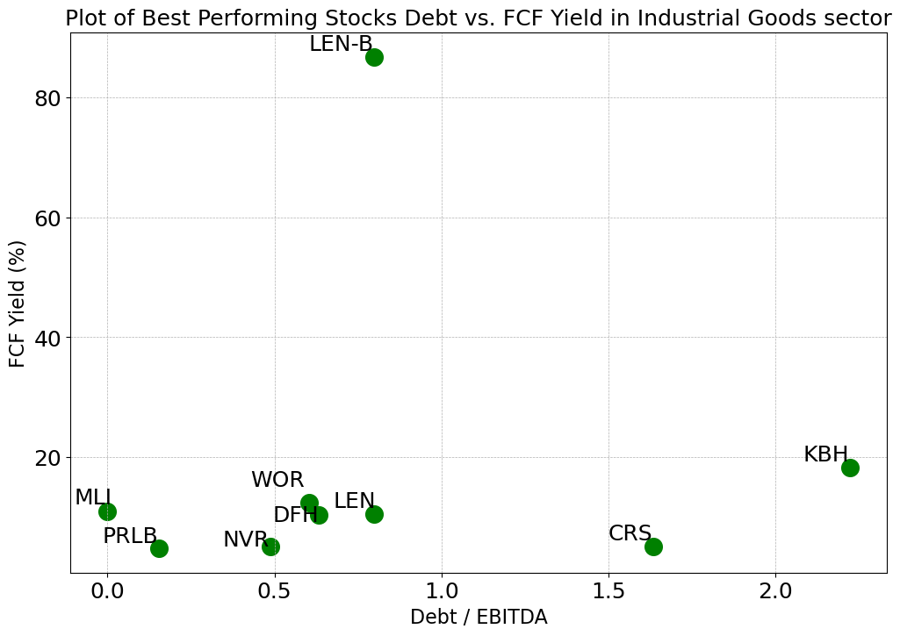
Industrial Goods Sector
The filtered 9 best-performing stocks have Debt/EBITDA between 0.0 and 2.5, compared to all 53 stocks with a range of -1.11~6.11 (negative exist because of negative EBITDA)
All but two of the best-performing stocks have a Dividend Yield between 1% and 2.1%, compared to all 53 stocks with a range of 0.0%~2.69%
The filtered 9 stocks have EPS Yields between 4% and 14%, compared to all stocks in -9.3%~19.12%
All but one of the 9 stocks have FCF Yields between 4% and 20%, compared to all stocks in -8.93%~12.35%

Slide 36
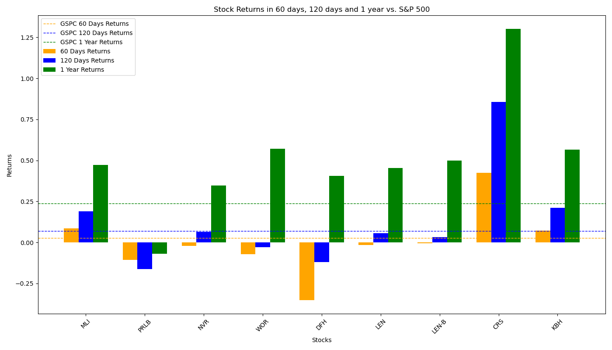
Performance of Filtered Stocks in Industrial Goods Sector
The portfolio performs under average in 60-day period, while its performance in long-term, however, is significantly good.
Total 9 Filtered Stocks | 60 Days | 120 Days | 1 Year
No. Stocks with Positive Returns | 3 | 6 | 8
No. Stocks with Returns Higher than S&P 500 | 3 | 3 | 8
Total Average Returns | 0.11% | 12.23% | 50.53%
Returns of S&P 500 | 2.65% | 6.89% | 23.62%

Slide 37
Industrials Sector
Among all 720 stocks in industrials sector, 441 of which move forward to analysis process. Other stocks are dropped because: 15 stocks lack EPS data; 10 stocks lack price data in a long period; 56 stocks lack debt data; 42 stocks lack shares data; 20 stocks lack EBITDA data; 133 stocks paid zero dividend; 3 stocks lack FCF data.
After eliminating outliers in the stocks by IQR method with sensitivity = 1.5 (This may drop out some best-performing stocks), the stocks in Financial Services sector have the following distribution:
Factors for Best-performing Filter:
X = 18, Y = 150,
Final Size of Portfolio = 20
 | Max | Min | Mean | Median
Debt/EBITDA | 7.12 | -3.06 | 1.94 | 1.75
Dividend Yield | 8.73% | 0.00% | 1.72% | 1.17%
EPS Yield | 13.10% | -3.86% | 4.79% | 4.52%
FCF Yield | 17.34% | -10.34% | 4.03% | 3.87%

Slide 38
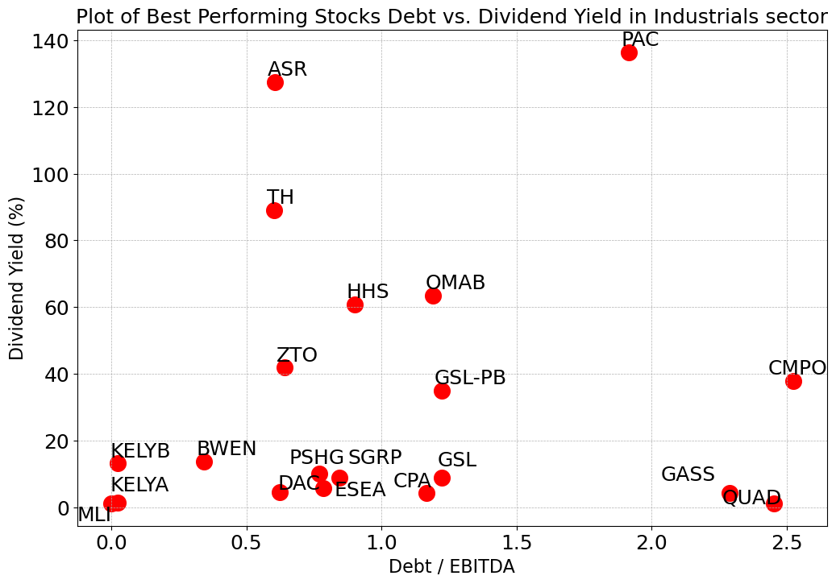
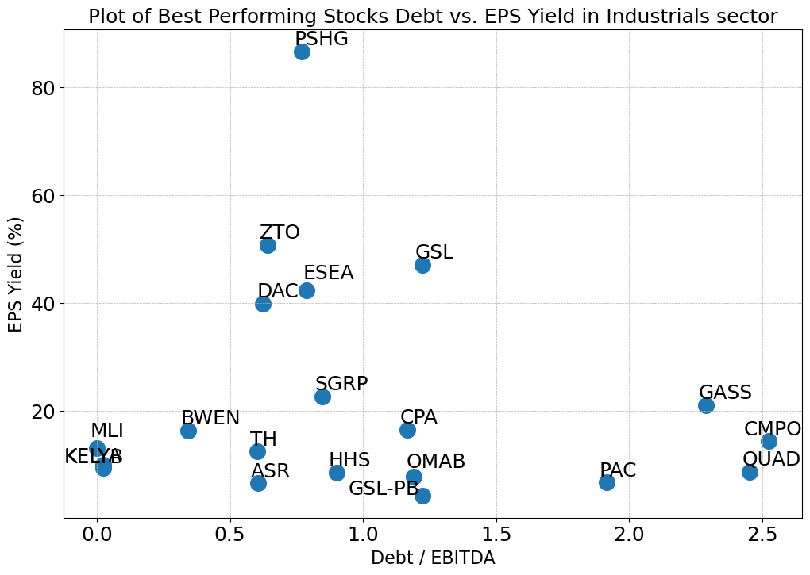
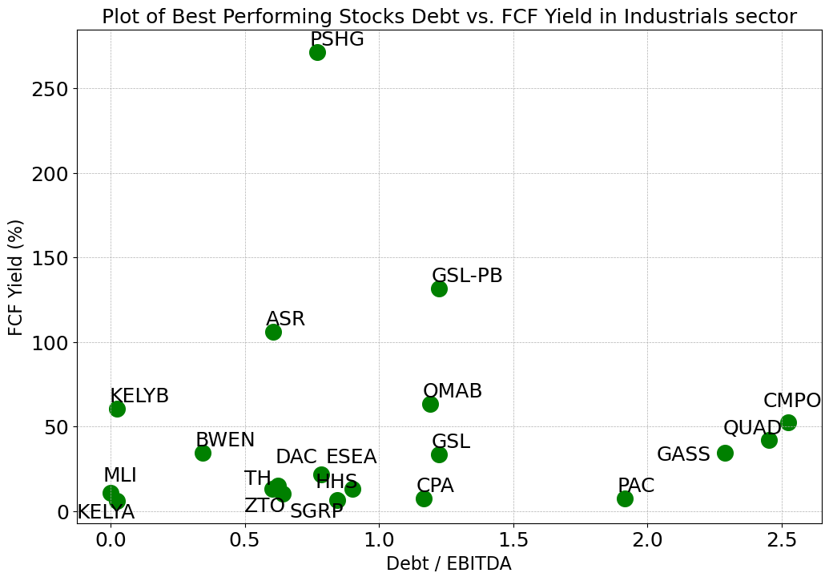
Industrials Sector
The filtered best-performing stocks have Debt/EBITDA between 0.0 and 2.6, compared to all 441 stocks with a range of -3.06~7.12 (negative exist because of negative EBITDA)
The filtered best-performing stocks have a Dividend Yield between 1% and 137%
All but one of the 20 stocks have EPS Yields between 4% and 51%, compared to all stocks in -3.86%~13.10%
All but one of the 20 stocks have FCF Yields between 6% and 132%, compared to all stocks in -10.34%~17.34%

Slide 39
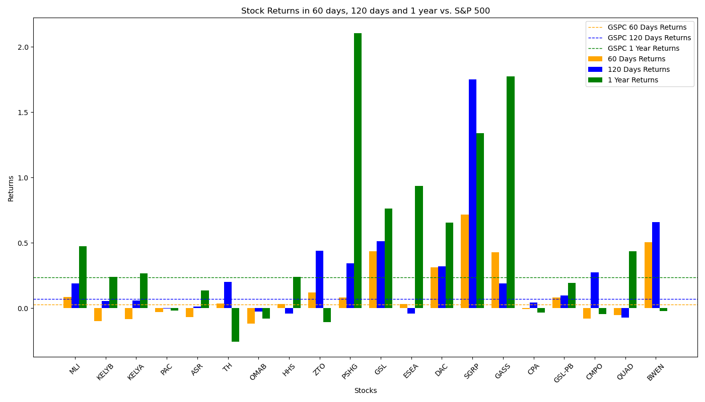
Performance of Filtered Stocks in Industrials Sector
Most Filtered Stocks perform very well in all three periods.
Total 20 Filtered Stocks | 60 Days | 120 Days | 1 Year
No. Stocks with Positive Returns | 12 | 16 | 13
No. Stocks with Returns Higher than S&P 500 | 12 | 11 | 11
Total Average Returns | 11.59% | 24.74% | 44.88%
Returns of S&P 500 | 2.65% | 6.89% | 23.62%

Slide 40
Services Sector
Among all 377 stocks in services sector, 220 of which move forward to analysis process. Other stocks are dropped because: 11 stocks lack EPS data; 3 stocks lack price data in a long period; 36 stocks lack debt data; 27 stocks lack shares data; 8 stocks lack EBITDA data; 71 stocks paid zero dividend; 1 stock lack FCF data.
After eliminating outliers in the stocks by IQR method with sensitivity = 1.5 (This may drop out some best-performing stocks), the stocks in Financial Services sector have the following distribution:
Factors for Best-performing Filter:
X = 20, Y = 100,
Final Size of Portfolio = 14
 | Max | Min | Mean | Median
Debt/EBITDA | 8.63 | -3.98 | 2.30 | 1.92
Dividend Yield | 10.62% | 0.00% | 2.25% | 1.59%
EPS Yield | 16.14% | -4.30% | 5.59% | 5.16%
FCF Yield | 22.04% | -13.10% | 4.18% | 4.54%

Slide 41
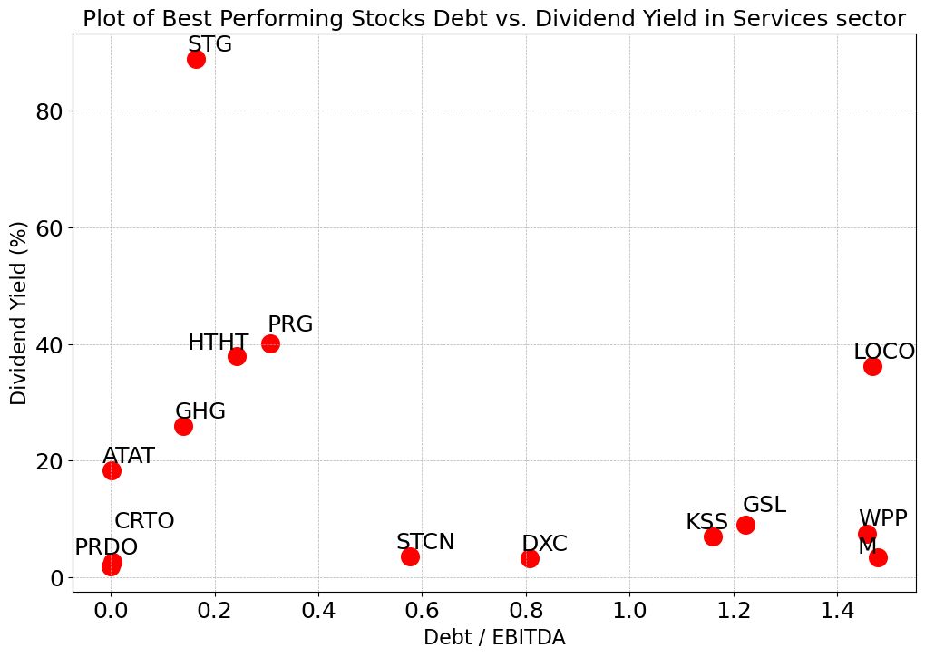
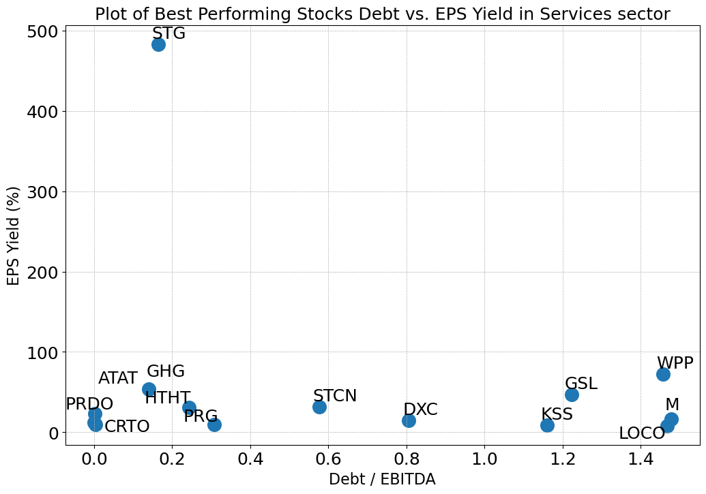
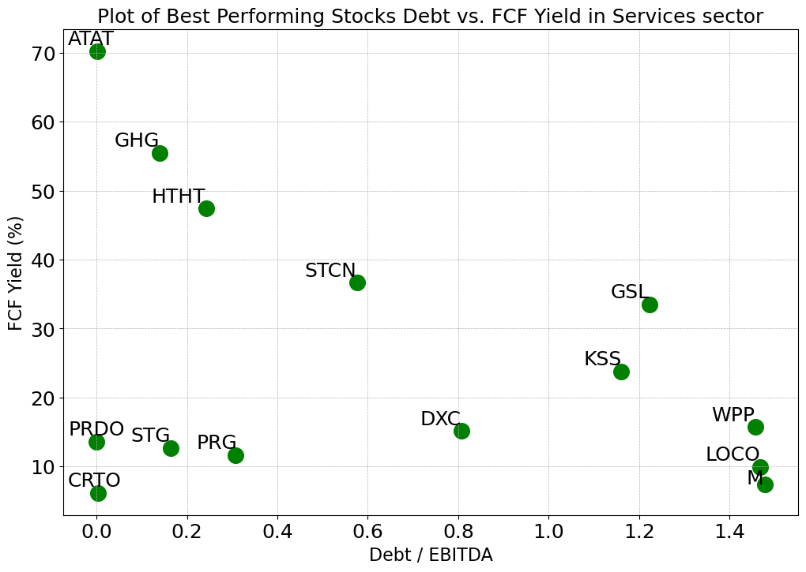
Services Sector
The filtered best-performing stocks have Debt/EBITDA between 0.0 and 1.5, compared to all 220 stocks with a range of -3.98~8.63 (negative exist because of negative EBITDA)
All but one of the best-performing stocks have a Dividend Yield between 1% and 40%, compared to all 220 stocks with a range of 0.00%~10.62%
All but one of the 14 stocks have EPS Yields between 8% and 90%, compared to all stocks in -4.30%~16.14%
The filtered 14 stocks have FCF Yields between 6% and 71%, compared to all stocks in -13.10%~22.04%

Slide 42
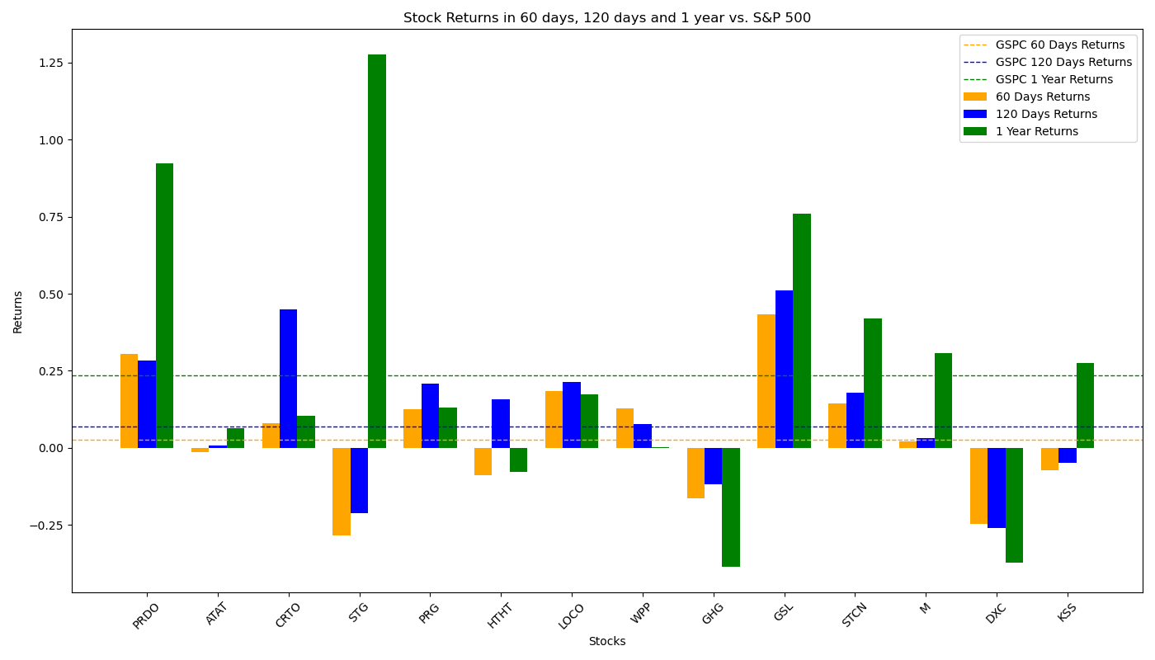
Performance of Filtered Stocks in Services Sector
The Filtered Investment Portfolio performs very good in all three time periods, especially in short terms when the returns it gives is twice of that of S&P 500.
Total 14 Filtered Stocks | 60 Days | 120 Days | 1 Year
No. Stocks with Positive Returns | 9 | 11 | 12
No. Stocks with Returns Higher than S&P 500 | 8 | 9 | 7
Total Average Returns | 3.96% | 10.60% | 25.72%
Returns of S&P 500 | 2.65% | 6.89% | 23.62%

Slide 43
Technology Sector
Among all 1057 stocks in technology sector, 465 of which move forward to analysis process. Other stocks are dropped because: 16 stocks lack EPS data; 13 stocks lack price data in a long period; 166 stocks lack debt data; 52 stocks lack shares data; 36 stocks lack EBITDA data; 306 stocks paid zero dividend; 3 stocks lack FCF data.
After eliminating outliers in the stocks by IQR method with sensitivity = 1.5 (This may drop out some best-performing stocks), the stocks in Financial Services sector have the following distribution:
Factors for Best-performing Filter:
X = 20, Y = 150,
Final Size of Portfolio = 19
 | Max | Min | Mean | Median
Debt/EBITDA | 8.02 | -4.82 | 1.51 | 0.84
Dividend Yield | 14.26% | 0.00% | 1.99% | 0.93%
EPS Yield | 17.41% | -13.47% | 3.53% | 3.97%
FCF Yield | 18.43% | -11.07% | 3.89% | 3.61%

Slide 44



Technology Sector
The filtered best-performing stocks have Debt/EBITDA between 0.0 and 2.5, compared to all 465 stocks with a range of -4.82~8.02 (negative exist because of negative EBITDA)
Most of the best-performing stocks have a Dividend Yield between 0.8% and 320%, compared to all 465 stocks with a range of 0.0%~14.26%
All but one stocks have EPS Yields between 4% and 210%, compared to all stocks in -13.47%~17.41%
Most of the 19 stocks have FCF Yields between 4% and 111%, and all but stocks are below 357% compared to all stocks in -11.07%~18.43%
*KSPI has been removed from the Dividend Yield, EPS Yield, and FCF and SONY has been removed from FCF since the numbers are extremely high

Slide 45

Performance of Filtered Stocks in Technology Sector
The Filtered Investment Portfolio performs worse than S&P 500 factors in 1-year period, but better in shorter terms.
Total 19 Filtered Stocks | 60 Days | 120 Days | 1 Year
No. Stocks with Positive Returns | 11 | 15 | 14
No. Stocks with Returns Higher than S&P 500 | 10 | 9 | 7
Total Average Returns | 4.42% | 10.96% | 17.13%
Returns of S&P 500 | 2.65% | 6.89% | 23.62%

Slide 46
Utilities Sector
Among all 97 stocks in utilities sector, 84 of which move forward to analysis process. Other stocks are dropped because: 1 stock lack EPS data; 1 stock lack price data in a long period; 2 stocks lack debt data; 7 stocks lack shares data; 6) 1 stock lack EBITDA data; 1 stock paid zero dividend.
After eliminating outliers in the stocks by IQR method with sensitivity = 1.5 (This may drop out some best-performing stocks), the stocks in Financial Services sector have the following distribution:
Factors for Best-performing Filter:
X = 50, Y = 50,
Final Size of Portfolio = 9
 | Max | Min | Mean | Median
Debt/EBITDA | 7.13 | 0.62 | 4.33 | 4.77
Dividend Yield | 8.62% | 0.05% | 3.77% | 3.76%
EPS Yield | 11.49% | 0.60% | 5.89% | 6.03%
FCF Yield | 10.54% | -17.91% | -2.27% | -3.07%

Slide 47



Utilities Sector
The filtered best-performing stocks have Debt/EBITDA between 0.0 and 3.5, compared to all 84 stocks with a range of 0.62~7.13 (negative exist because of negative EBITDA)
Most of the best-performing stocks have a Dividend Yield between 4% and 31%, compared to all 84 stocks with a range of 0.05%~8.62%
Most of the 9 stocks have EPS Yields between 7% and 38%, compared to all stocks in 0.60%~11.49%
Most of the 9 stocks have FCF Yields between 8% and 90%, compared to all stocks in -17.91%~10.54%
*ENIC and CEPU have been removed from the Dividend Yield plot, EPS and FCF Yield plot since their numbers are extremely high

Slide 48

Performance of Filtered Stocks in Utilities Sector
The Filtered Investment Portfolio performs worse than S&P 500 factors in 60-day and 1-year period, especially in 60-day when the returns fail to get positive.
Total 9 Filtered Stocks | 60 Days | 120 Days | 1 Year
No. Stocks with Positive Returns | 6 | 7 | 6
No. Stocks with Returns Higher than S&P 500 | 3 | 4 | 3
Total Average Returns | -1.33% | 10.26% | 14.52%
Returns of S&P 500 | 2.65% | 6.89% | 23.62%

